Slide 1


Behavioral modeling in social networks from micro to macro
Meng Jiang, University of Illinois at Urbana-Champaign
Peng Cui, Tsinghua University
http://www.meng-jiang.com/tutorial-icdm15.html
ICDM 2015 TUTORIAL
Atlantic City, NJ
Notes:
Download slides from our website.

Slide 2



Thanks to
National Natural Science Foundation of China,
No. 61370022, No. 61210008, No. 61303075
International Science & Technology Cooperation Program of China,
No. 2013DFG12870
National Program on Key Basic Research Project,
No. 2011CB302206, No. 2015CB352300
NExT Research Center funded by MDA, Singapore,
WBS:R-252-300-001-490
Tsinghua-Tencent Joint Laboratory
Notes:
Thank the foundations, programs and projects that support us to do our research.

Slide 3
introduction
Behavior Modeling in Social Networks

Slide 4
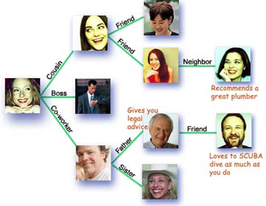
User Behavior
Users
Relations
User-user interaction behaviors
User-information interaction behaviors
Information
User behavior is a fundamental element in social networks
Notes:
User behavior is a fundamental unit in social networks.

Slide 5
Behavioral Modeling
Understanding
Predicting
Intervening
Notes:
User behavior is a fundamental unit in social networks, so many problems can be studied from behavioral angel.

Slide 6
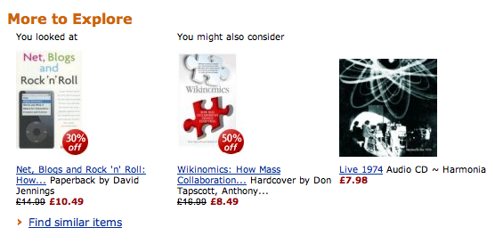




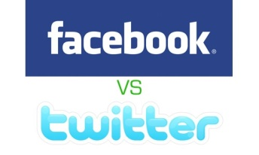



Applications of Behavioral Modeling
Recommendation
Targeting AD
Anti Spam
Notes:
How to model user behaviors is of paramount importance for many real applications.

Slide 7

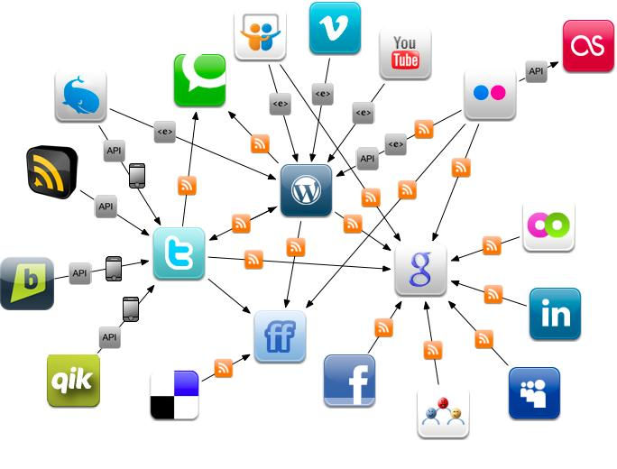
Scientific Significance of Behavioral Modeling
Physical World
Online Social Networks
The human behaviors are broadly and deeply
recorded in an unprecedented level.
This is the first time that we can get insights of human behaviors and the society from large scale real data.
Notes:
This is the first time that we can get insights of human behaviors and the society from large scale real data.

Slide 8
Six Disruptive Basic Research Areas, by DOD
Notes:
DOD (Department of Defense) also list computation modeling of human behaviors as one of the six disruptive basic research directions.

Slide 9
Notes:
DOD (Department of Defense) also list computation modeling of human behaviors as one of the six disruptive basic research directions.

Slide 10
User Behaviors are Complex
Content
User Behavior
Context
Social
Intention
Notes:
User behaviors in social networks are complex. Will explain the four factors one by one.

Slide 11
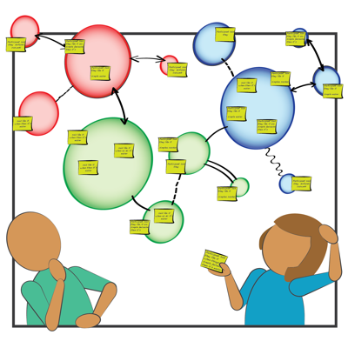
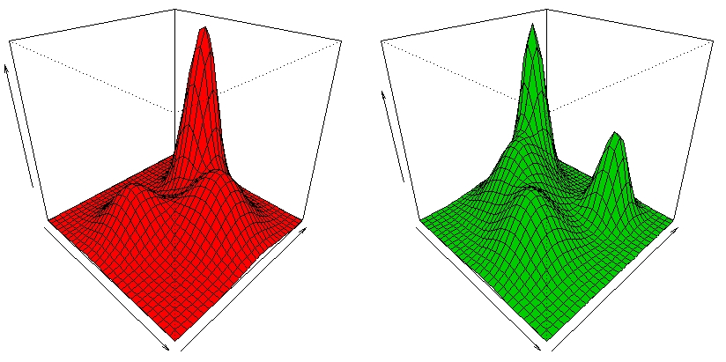
Content Related
User preference is an important driving factor for user behavior modeling.
Notes:
Preference and content.

Slide 12
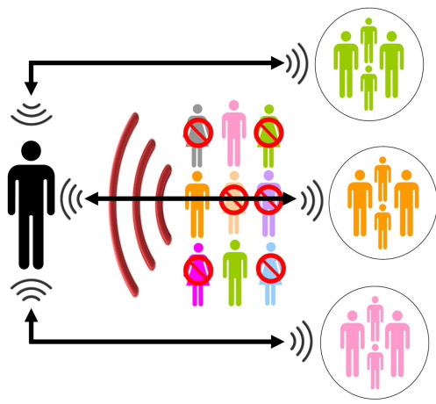
Social Related
User behavior in social networks are highly dependent on social peers.
Notes:
Social relation, trust, influence. Decisions depends on not only ourselves but also our friends.

Slide 13
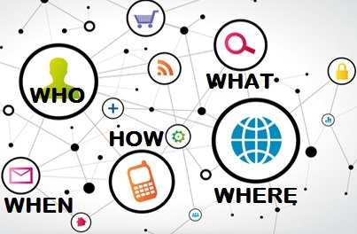
Context Related
Rich context info in social networks. How to couple them with behavioral modeling?
Notes:
Our decisions, say, what we want and we may have depends on not only who we are, what we may choose, but also where we are, when it is, how we can get the information.

Slide 14
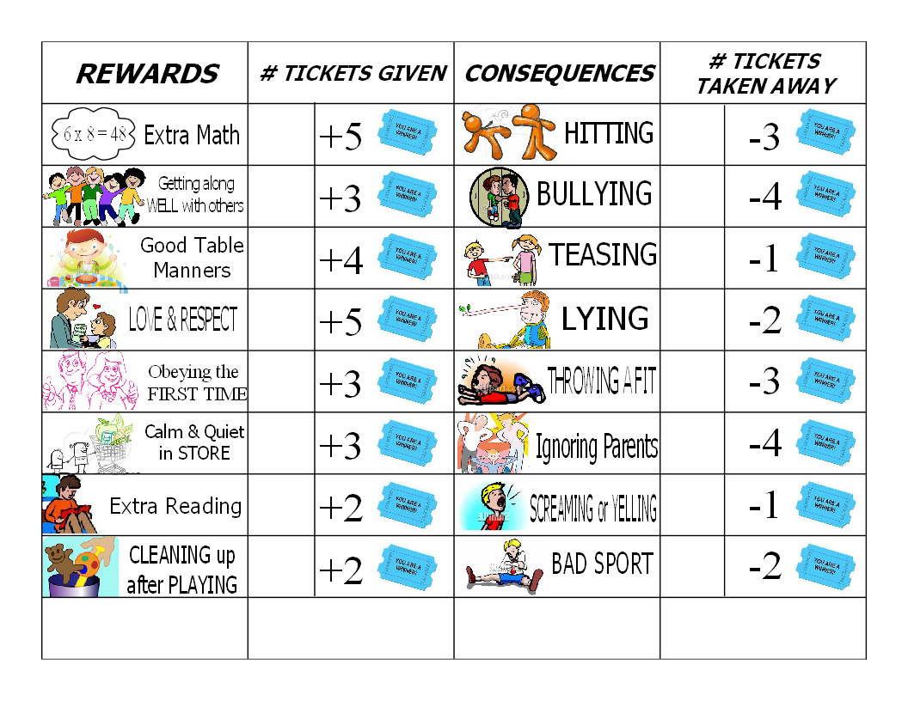
Intention Related
A nontrivial part of user behaviors are from profitable and social purposes.
Intention can account for the behaviors that cannot be well interpreted by content, social and context.
Notes:
Intentions: good or bad. We want something because… we want interesting information, the recent news about some event, money from our promotional advertisements.

Slide 15
Behavioral Modeling
Content
Understand single factors
Understand their couplings
Unify them for behavior modeling and prediction
User Behavior
Context
Social
Intention
Notes:
Challenges of behavioral modeling
Highly sparse
Highly dimensional
Highly dynamic

Slide 16
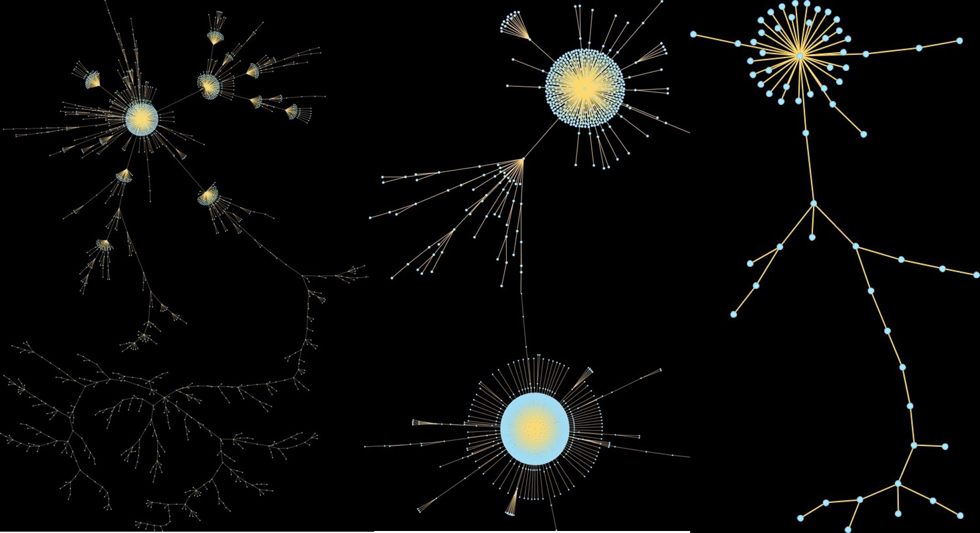


Granularities of User Behavior
User Behavior
Microscopic
Macroscopic
Personalized
Global
Individual behavior analysis and prediction
Propagation analysis and prediction

Slide 17
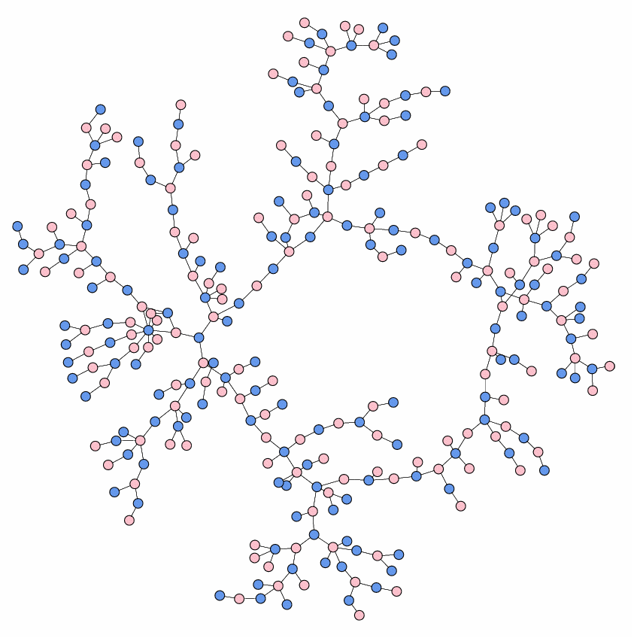

In This Tutorial
Micro
Individual
behavior
Natural
behavior
Information
cascade
Intention
Macro
Unnatural/Suspicious
behavior
Notes:
In this tutorial
Micro-Individual behavior modeling
Macro-information spreading
Suspicious behavior modeling
Discussions

Slide 18
Outline
Prediction for natural behavior
Modeling individual behavior (MICRO)
Modeling information cascade (MACRO)
Detection for unnatural behavior
Suspicious behavior detection

Slide 19
Questions for Modeling Individual Behavior
What is individual behavior in social networks?
Why should we study individual behavior?
What are the state-of-the-art models?
Modeling behaviors and social relations
Modeling social contexts
Modeling spatiotemporal contexts
Modeling multiple domains in social networks

Slide 20
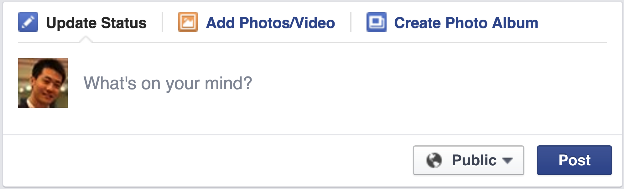
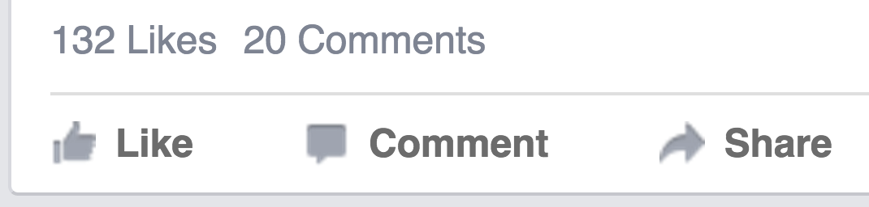
Individual Behavior: Facebook
Post: What’s on your mind?
Like, Comment, Share
Notes:
Users, creators : who generated data.

Slide 21
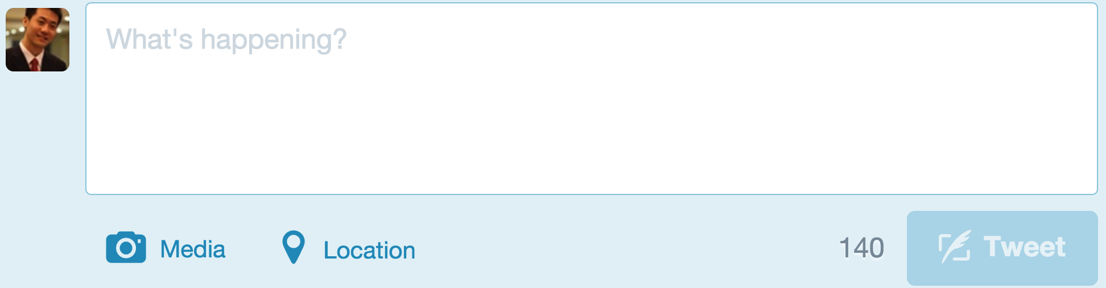
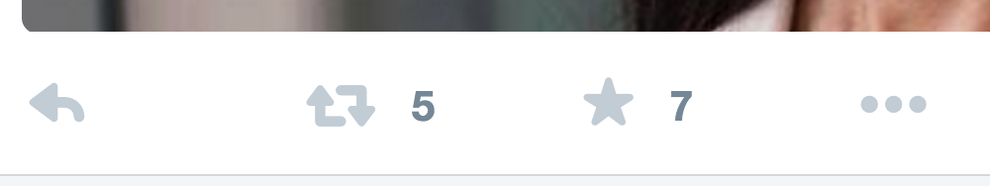
Individual Behavior: Twitter
Tweet: What’s happening?
Reply, Retweet, Favorite
Notes:
Users, sensors: who collected data.

Slide 22
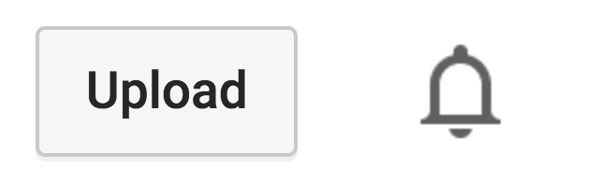
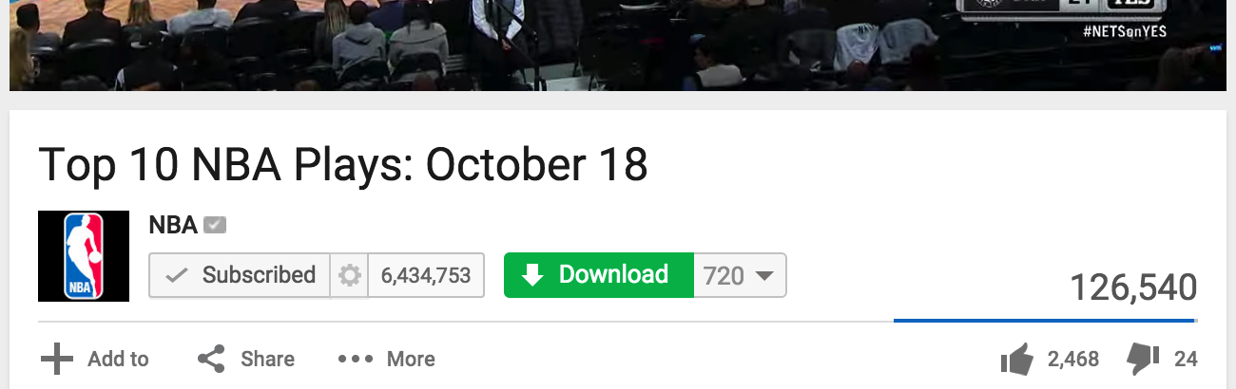
Individual Behavior: YouTube
Upload
Subscribe, Download, Add to, Share, Like, Dislike, Comment

Slide 23
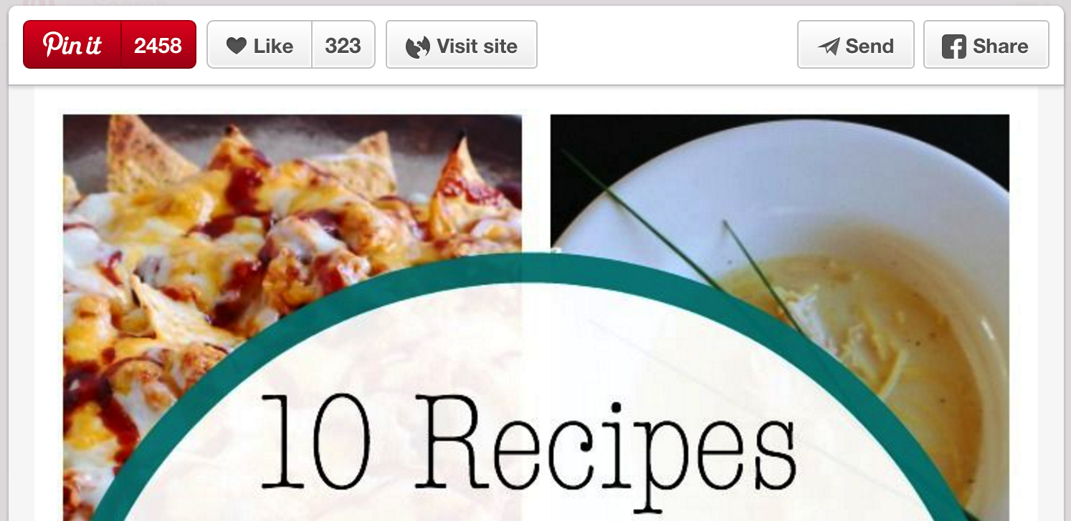
Individual Behavior: Pinterest
Pin it, Like, Visit, Send, Share

Slide 24

“Information Adoption” in Social Networks
Like
Reply
Share
Favorite
Retweet
Comment
Subscribe
Download
Add to
Send
Pin it
Visit
……
Notes:
Types of information adoption behaviors.

Slide 25
Modeling Information Adoption Behavior
Behavioral pattern discovery
Behavior prediction in social networks
Social recommendation
Notes:
Why should we modeling information adoption? And how?

Slide 26
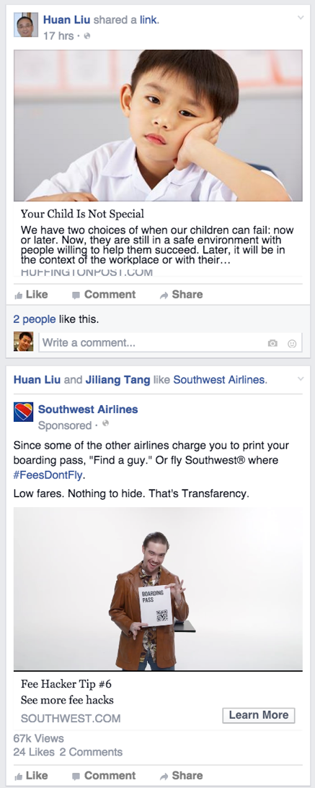
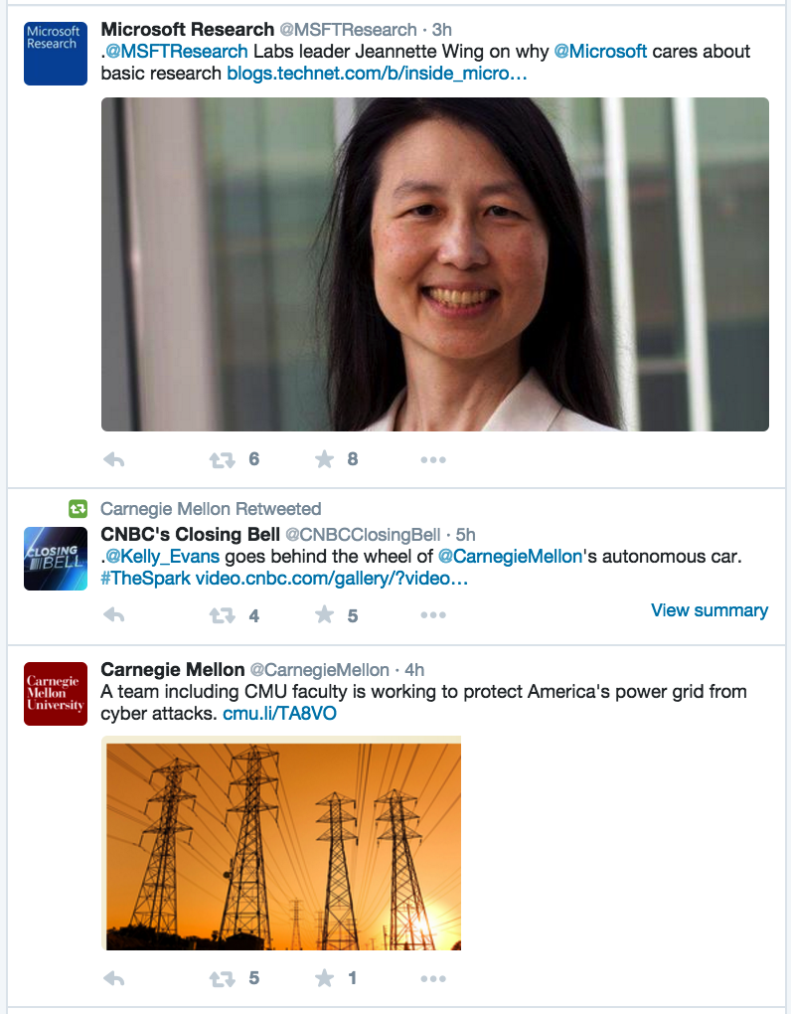
What is Social Recommendation?
Facebook
Twitter
News
Feed
Ranking

Slide 27

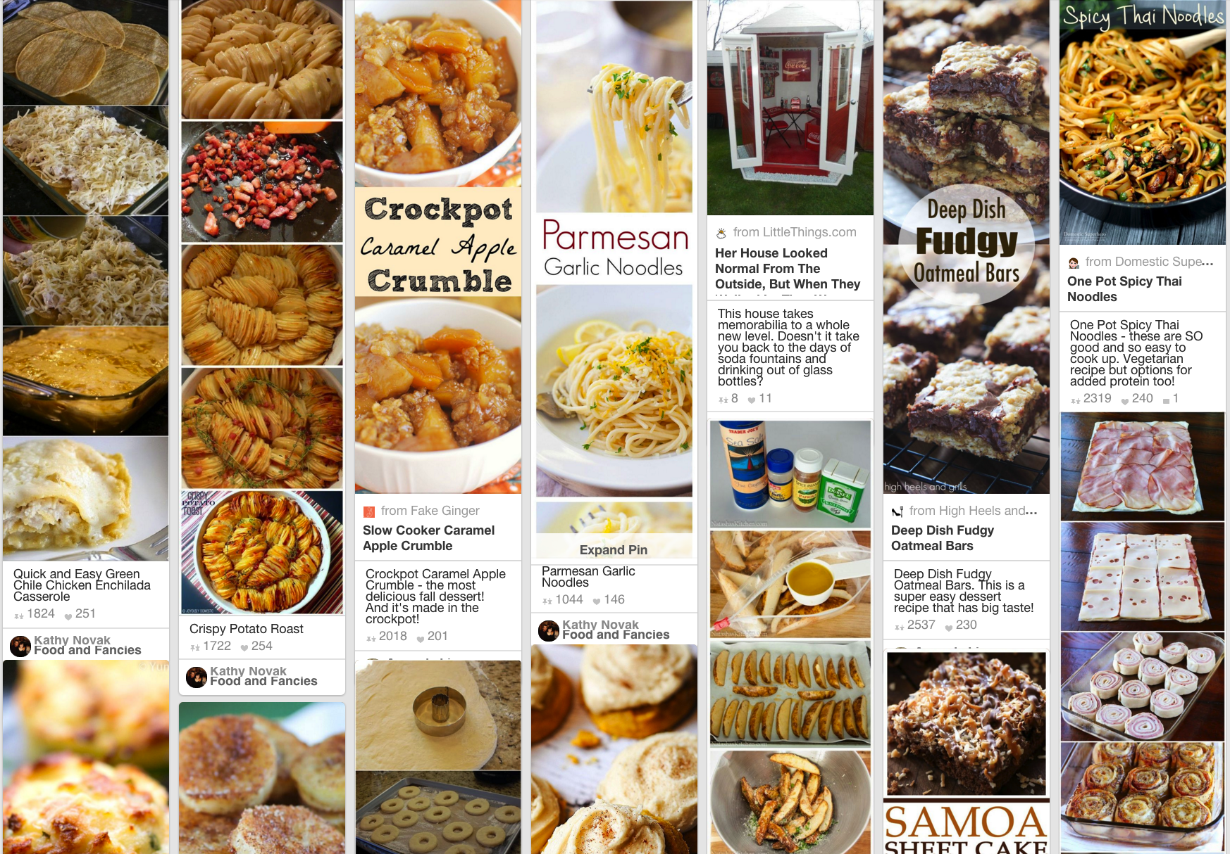
What is Social Recommendation?
YouTube
Pinterest
Social Multimedia
Recommender Systems

Slide 28
What is Social Recommendation?
“Social recommendation …, however, it has no commonly accepted definition.”
Tang et al. Social Recommendation: A Review. Social Network Analysis and Mining, 2013. Springer.
Notes:
Jiliang Tang, KDD 2015 Dissertation Award Runner-up. Survey paper.

Slide 29
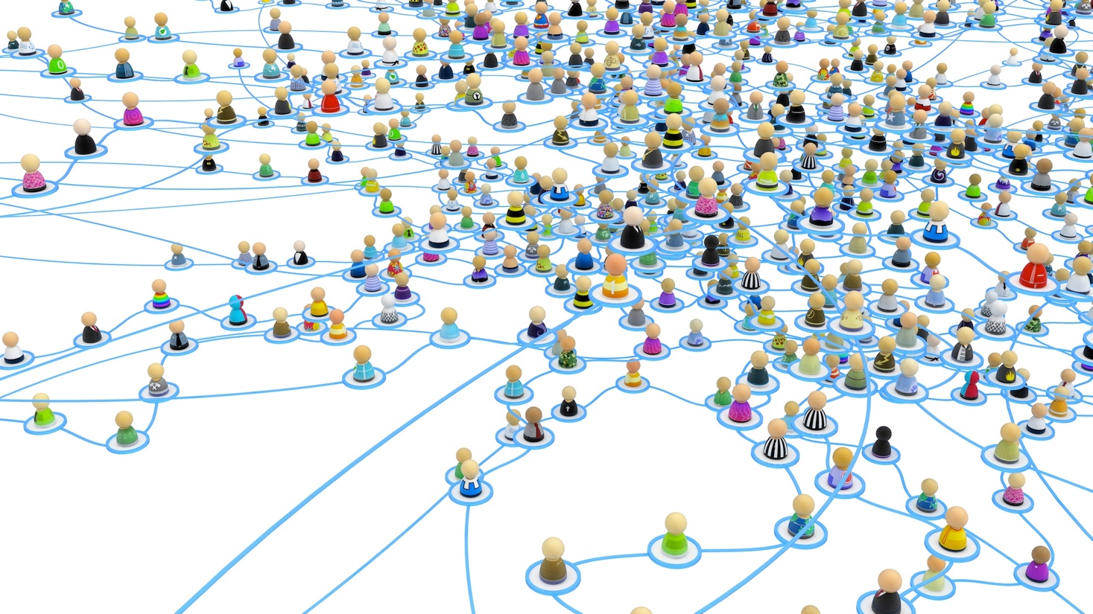
What is Social Recommendation?
“Social recommendation …, however, it has no commonly accepted definition.”
“A narrow definition of social recommendation is any recommendation with online social relations as an additional input, i.e., augmenting an existing recommendation engine with additional social signals.”
Tang et al. Social Recommendation: A Review. Social Network Analysis and Mining, 2013. Springer.

Slide 30
What is Social Recommendation?
“Social recommendation …, however, it has no commonly accepted definition.”
“A narrow definition of social recommendation is any recommendation with online social relations as an additional input, i.e., augmenting an existing recommendation engine with additional social signals.”
“Users’ preferences are likely to be similar to or influenced by their connected friends. …, social recommendation leverages user correlations implied social relations to improve the performance of recommendation.”
Tang et al. Social Recommendation: A Review. Social Network Analysis and Mining, 2013. Springer.
Notes:
To better understand the difference between social recommendation and traditional recommendation in methodology level, we need first to know how to do traditional recommendation.

Slide 31
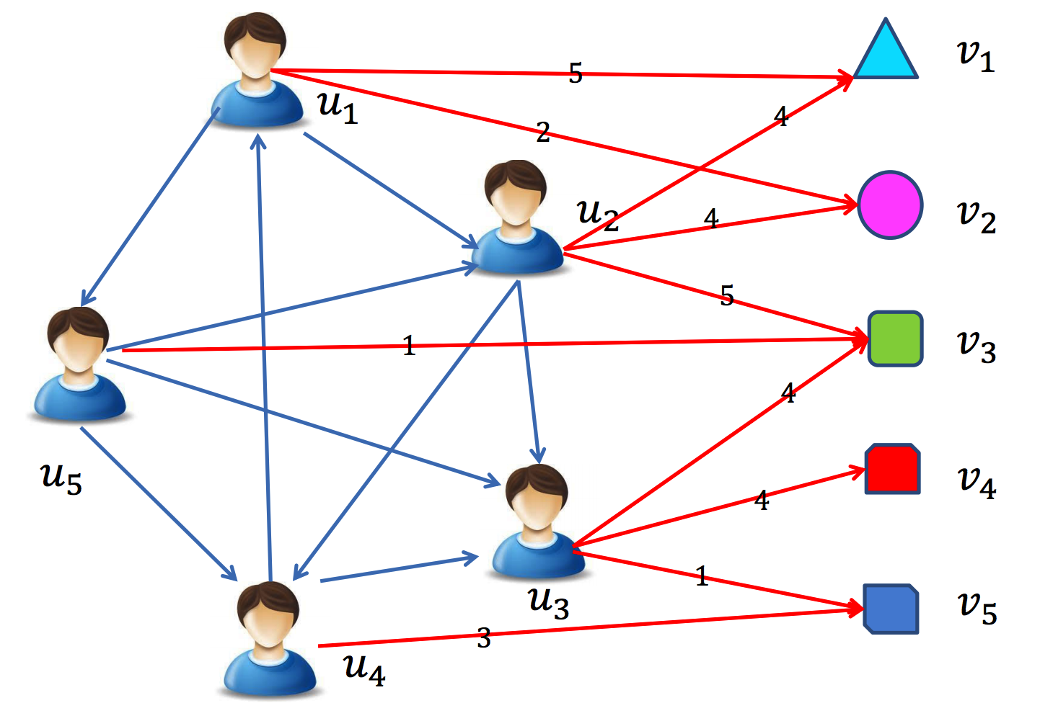
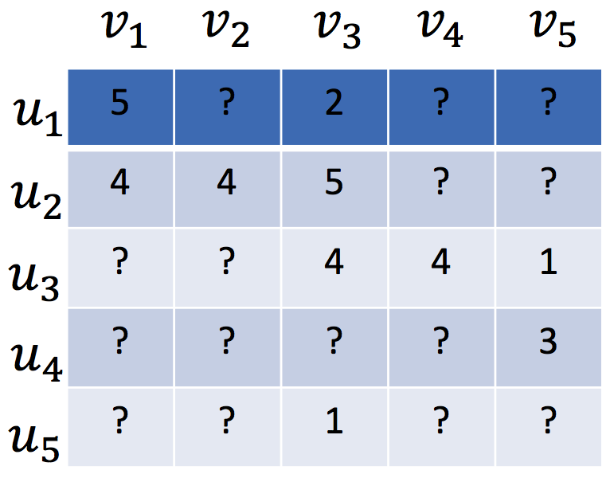
Traditional Recommender Systems
Assumed that users are independent and identically distributed
Tang et al. Social Recommendation: A Review. Social Network Analysis and Mining, 2013. Springer.
Notes:
Sparse user-item matrix.

Slide 32
Traditional Recommender Systems
Content-based recommender (e.g., TFIDF)
For textual information (e.g., news, documents)
Limitation: limited content analysis, over-specialization
Tang et al. Social Recommendation: A Review. Social Network Analysis and Mining, 2013. Springer.
Notes:
Three. First, NLP work.

Slide 33
Traditional Recommender Systems
Content-based recommender (e.g., TFIDF)
For textual information (e.g., news, documents)
Limitation: limited content analysis, over-specialization
Collaborative filtering based recommender
Memory-based CF (e.g., PCC, similarity)
Model-based CF (e.g., factorization based)
Limitation: data sparsity, cold-start problem
Hybrid recommender system
Tang et al. Social Recommendation: A Review. Social Network Analysis and Mining, 2013. Springer.
Notes:
Second, CF. What is cold-start?

Slide 34
Matrix Factorization based CF (MF)
Low-rank MF on the user-item rating matrix R
User preference vector U
Item characteristic vector V
R
U
V^{T}
Koren. Factorizatoin Meets the Neighborhood: A Multifaceted Collaborative Filtering Model. KDD, 2008.
Notes:
Dr. Yehuda Koren. Matrix factorization. Latent factors.

Slide 35
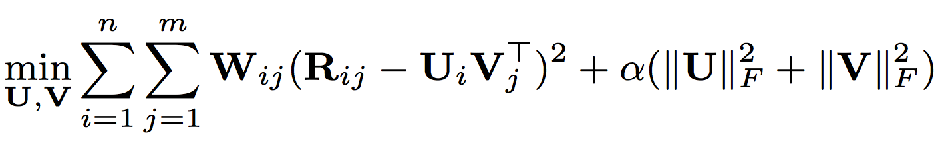
Matrix Factorization based CF (MF)
Low-rank MF on the user-item rating matrix R
User preference vector U
Item characteristic vector V
Observed weight matrix W
avoid over-fitting,
controlled by the parameter
Koren. Factorizatoin Meets the Neighborhood: A Multifaceted Collaborative Filtering Model. KDD, 2008.
Notes:
Observed indicators. Regularization to avoid over-fitting.

Slide 36
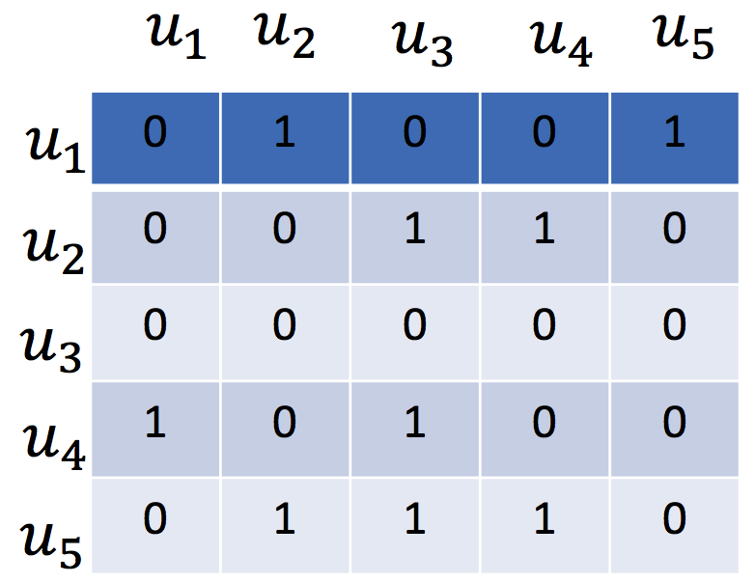
Social Recommendation
Social relations
Tang et al. Social Recommendation: A Review. Social Network Analysis and Mining, 2013. Springer.
Notes:
One more matrix input.

Slide 37
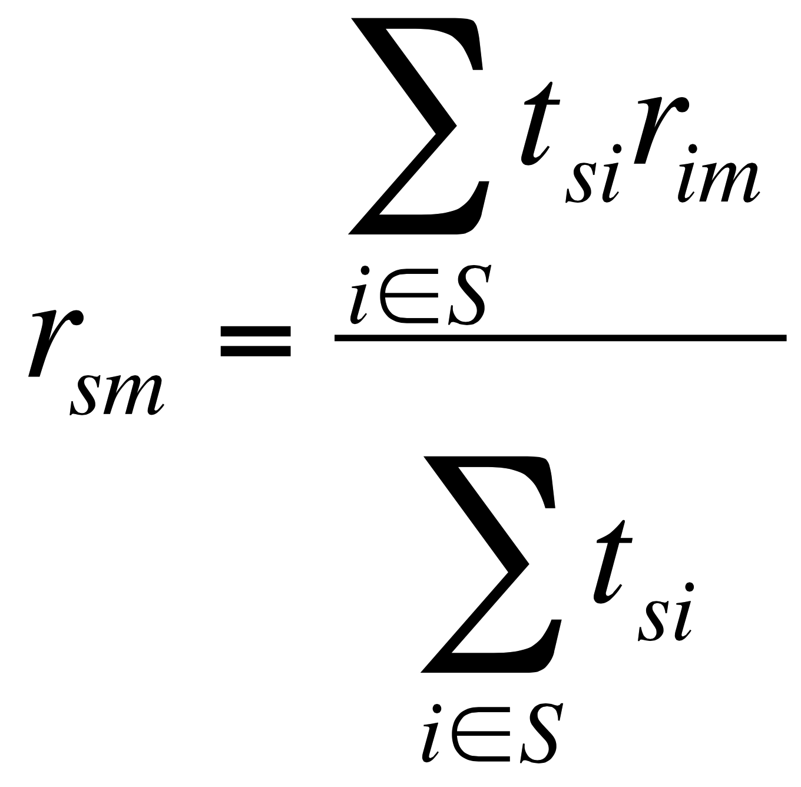
Memory based Social Recommender
TidalTrust
rating
(user i, item m)
rating
(user s, item m)
trust from social relation
(user s, user i)
Golbeck. Personalizing applications through integration of inferred trust values in semantic web-based social networks. Semantic Network Analysis Workshop, 2005.
Notes:
Average score of friends’ ratings on the same item.

Slide 38
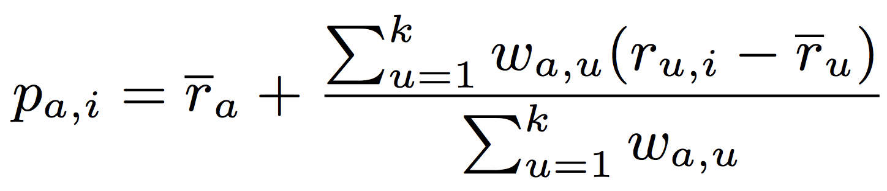
Memory based Social Recommender
MoleTrust
rating
(user u, item i)
average rating
(user u)
average rating
(user a)
predicted rating
(user a, item i)
trust from social relation
(user a, user u)
Massa et al. Trust-aware recommender systems. RecSys, 2007.
Notes:
Your preference bias on a given item. Your rating to the given item is over or below your average rating.

Slide 39
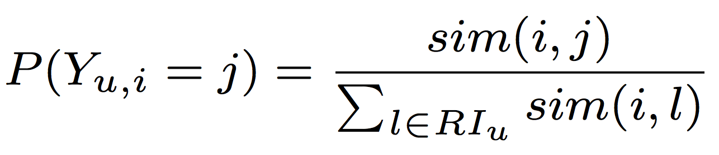
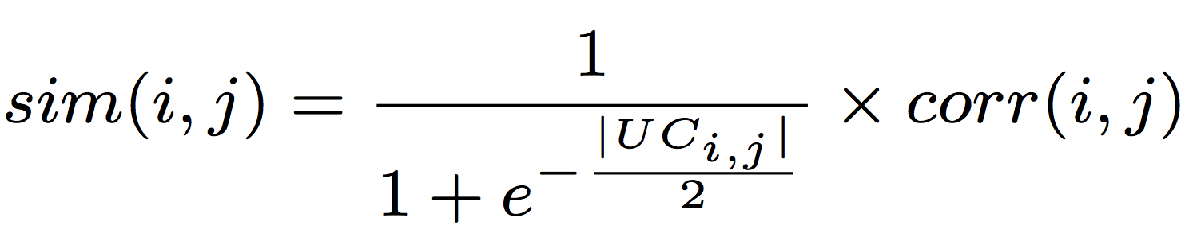
Memory based Social Recommender
similarity measure
(item i, item j)
TrustWalker
probability of
user u’s random walk
from item i to item j
Pearson correlation
of (item i, item j)
common user set
of (item i, item j)
Jamali et al. TrustWalker: A Random Walk Model for Combining Trust-based and Item-based Recommendation. KDD, 2009.
Notes:
Only the given item? What if we compute the similarity between items?

Slide 40
Model based Social Recommender
Optimization methods such as gradient based methods can be applied to find a well-worked optimal solution.
MF has a nice probabilistic interpretation with Gaussian noise.
MF is very flexible and allows us to include prior knowledge.
Social Recommendation CF
= Basic CF + Social Information Model
Tang et al. Social Recommendation: A Review. Social Network Analysis and Mining, 2013. Springer.
Notes:
Model based: Use matrix factorization for social recommender.

Slide 41
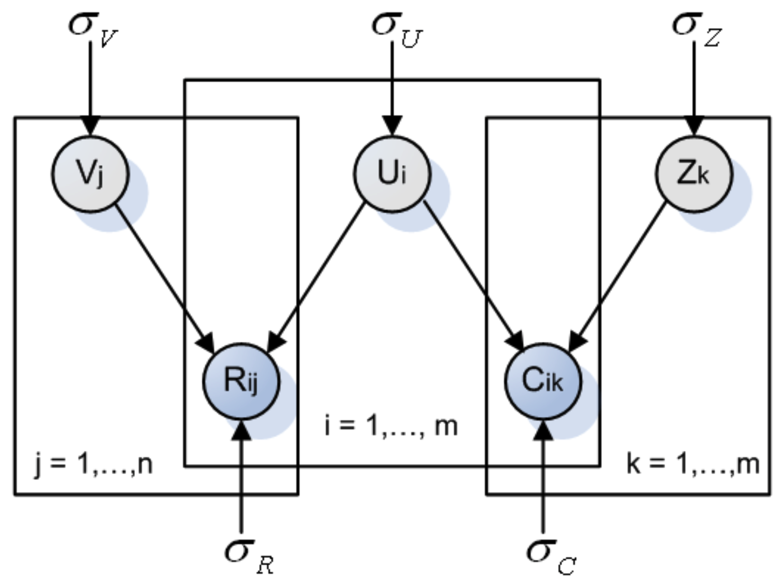
Model based Social Recommender
factor vector
SoRec
item vector
user vector
R: user-item
rating matrix
C: user-user
social matrix
Ma et al. Social Recommendation Using Probabilistic Matrix Factorization. CIKM, 2008. Improving Recommender Systems by Incorporating Social Contextual Information. TIS, 2011.
Notes:
Optimize user vector with both rating matrix and social matrix with probabilistic graphical model.

Slide 42
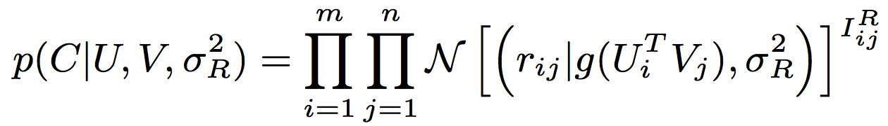
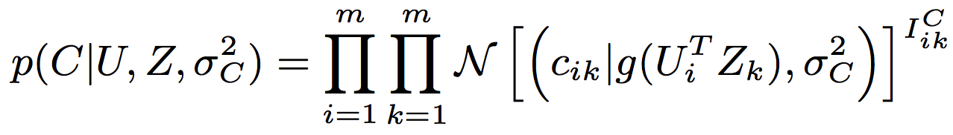
Model based Social Recommender
SoRec
R
Gaussian distribution
Logistic function
Observed
Ma et al. Social Recommendation Using Probabilistic Matrix Factorization. CIKM, 2008. Improving Recommender Systems by Incorporating Social Contextual Information. TIS, 2011.
Notes:
Observation indicator, Gaussian distribution, logistic function.

Slide 43
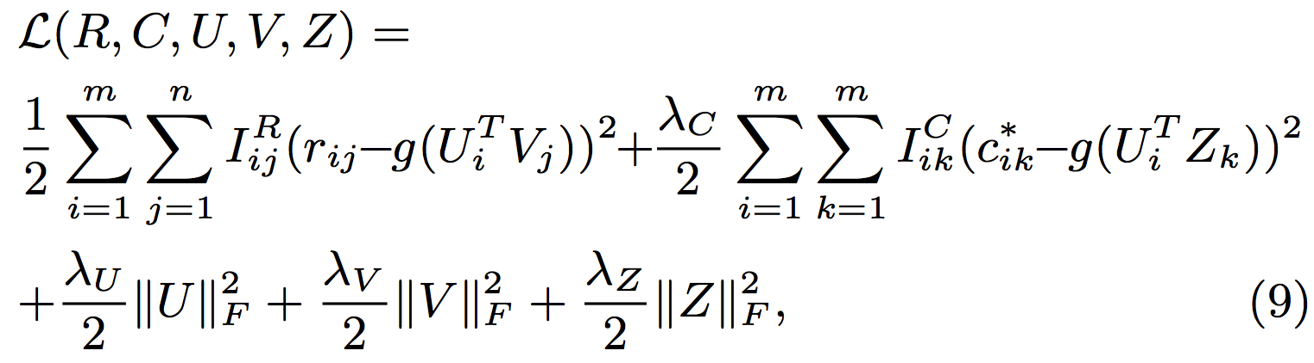
Model based Social Recommender
SoRec
behavioral term
social term
regularization terms
Ma et al. Social Recommendation Using Probabilistic Matrix Factorization. CIKM, 2008. Improving Recommender Systems by Incorporating Social Contextual Information. TIS, 2011.
Notes:
Behavioral term, social term, regularization terms.

Slide 44
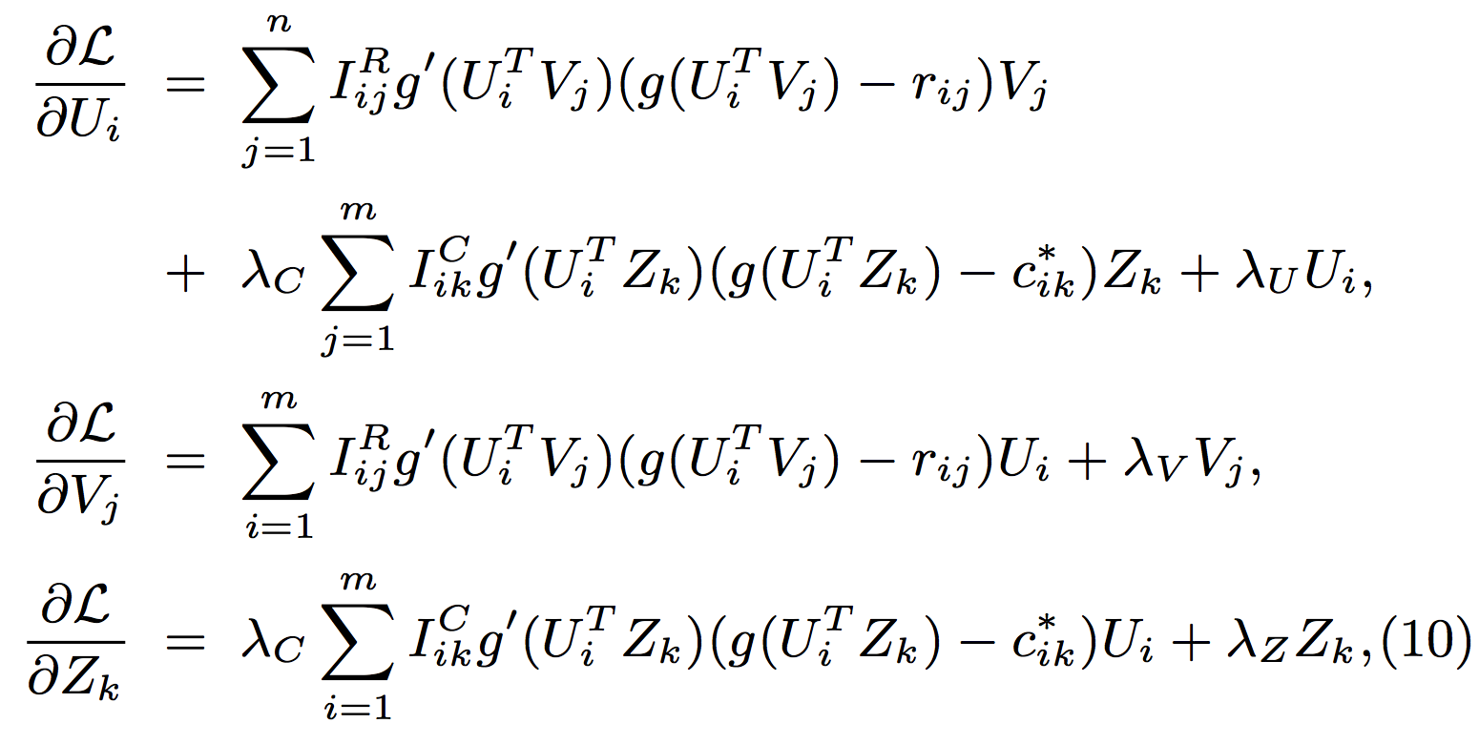
Model based Social Recommender
SoRec
Gradient Descent Methods
deviate of
Logistic
function
Ma et al. Social Recommendation Using Probabilistic Matrix Factorization. CIKM, 2008. Improving Recommender Systems by Incorporating Social Contextual Information. TIS, 2011.

Slide 45
Model based Social Recommender
SoRec
Ma et al. Social Recommendation Using Probabilistic Matrix Factorization. CIKM, 2008. Improving Recommender Systems by Incorporating Social Contextual Information. TIS, 2011.
Notes:
Review the whole framework of SoRec.

Slide 46
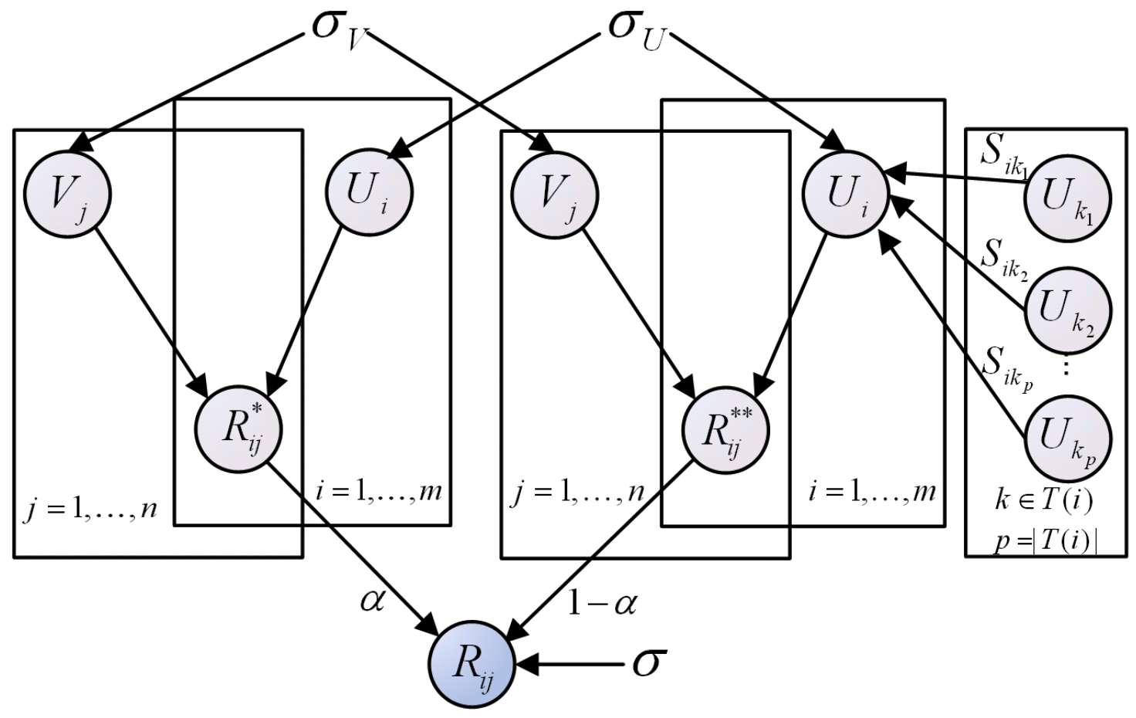
Model based Social Recommender
Replacing social with trust
“Social Trust” Ensemble for Epinion data
From user-item
matrix
From trusted friends
Operation “plus”
Ma et al. Learning to Recommend with Social Trust Ensemble. SIGIR, 2009. Learning to Recommend with Explicit and Implicit Social Relations. TIST, 2011.
Notes:
Modeling social trust into the factorization framework: Rating and trust. Trade-off. Parameter alpha.

Slide 47
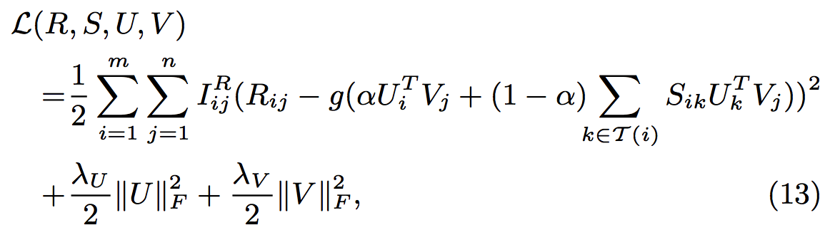
Model based Social Recommender
“Social Trust” Ensemble
From user-item
matrix
From trusted friends
Ma et al. Learning to Recommend with Social Trust Ensemble. SIGIR, 2009. Learning to Recommend with Explicit and Implicit Social Relations. TIST, 2011.
Notes:
Trade-off.

Slide 48
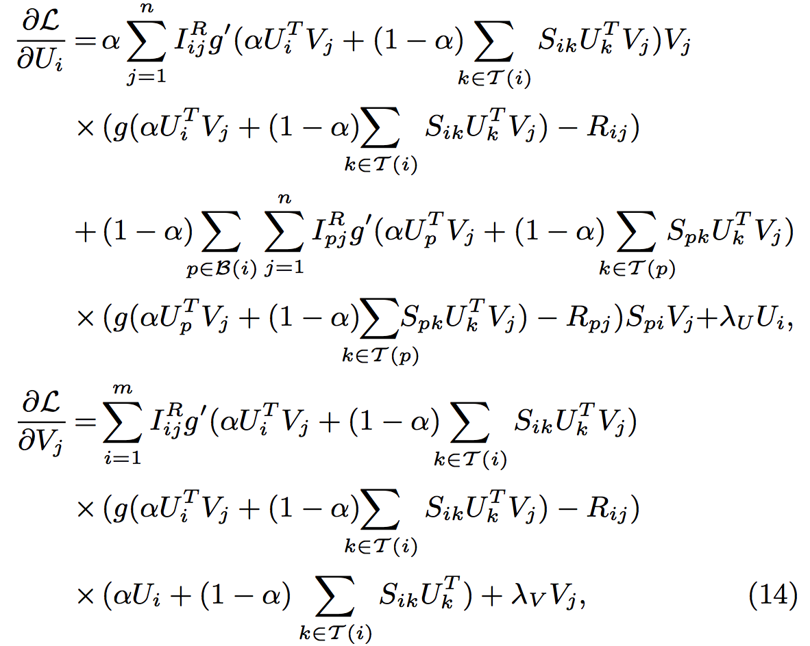
Model based Social Recommender
“Social Trust” Ensemble
Gradient
Descent
Methods
Ma et al. Learning to Recommend with Social Trust Ensemble. SIGIR, 2009. Learning to Recommend with Explicit and Implicit Social Relations. TIST, 2011.

Slide 49
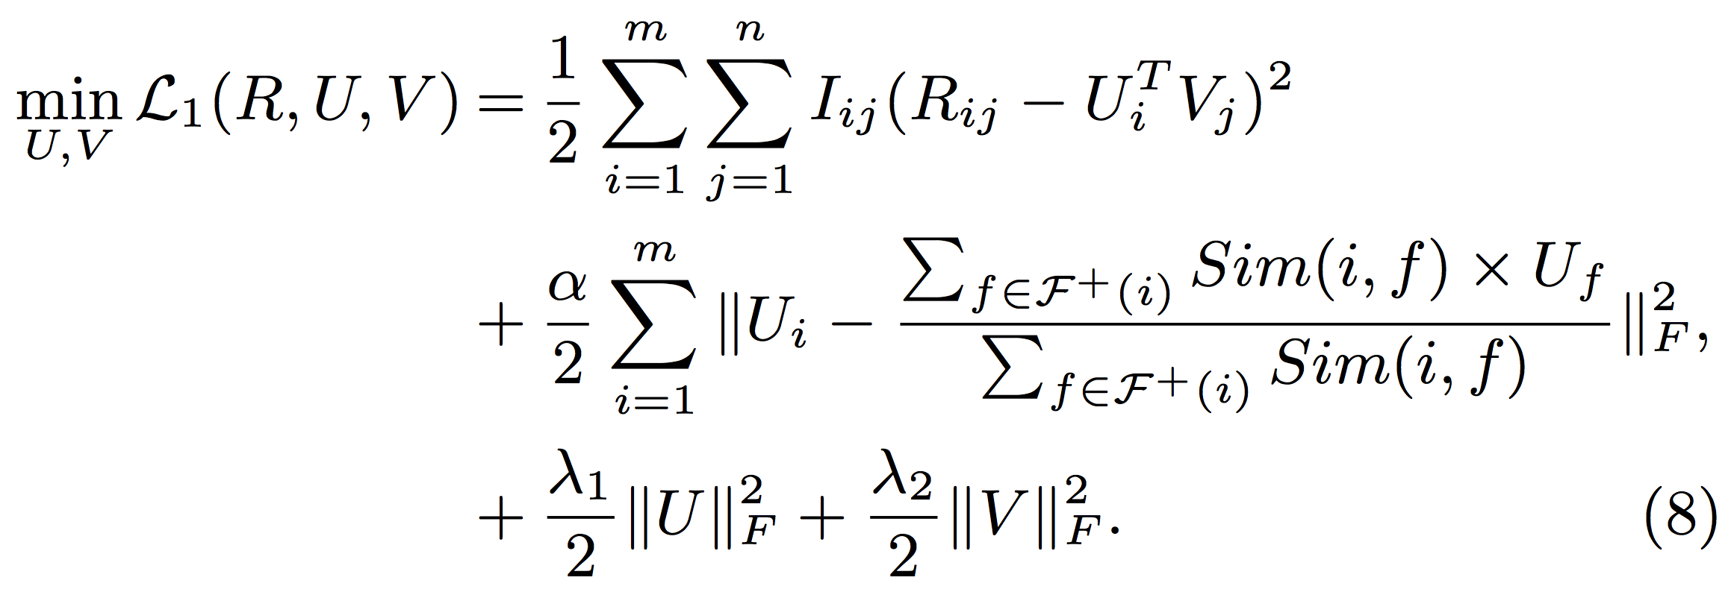
Model based Social Recommender
SoReg
Average-based regularization:
Regularize with the average of friends’ tastes
Information loss: Friends may have diverse tastes!!!
Ma et al. Recommender Systems with Social Regularization. WSDM, 2011.
Notes:
Your tastes are similar with the average tastes of your friends?

Slide 50
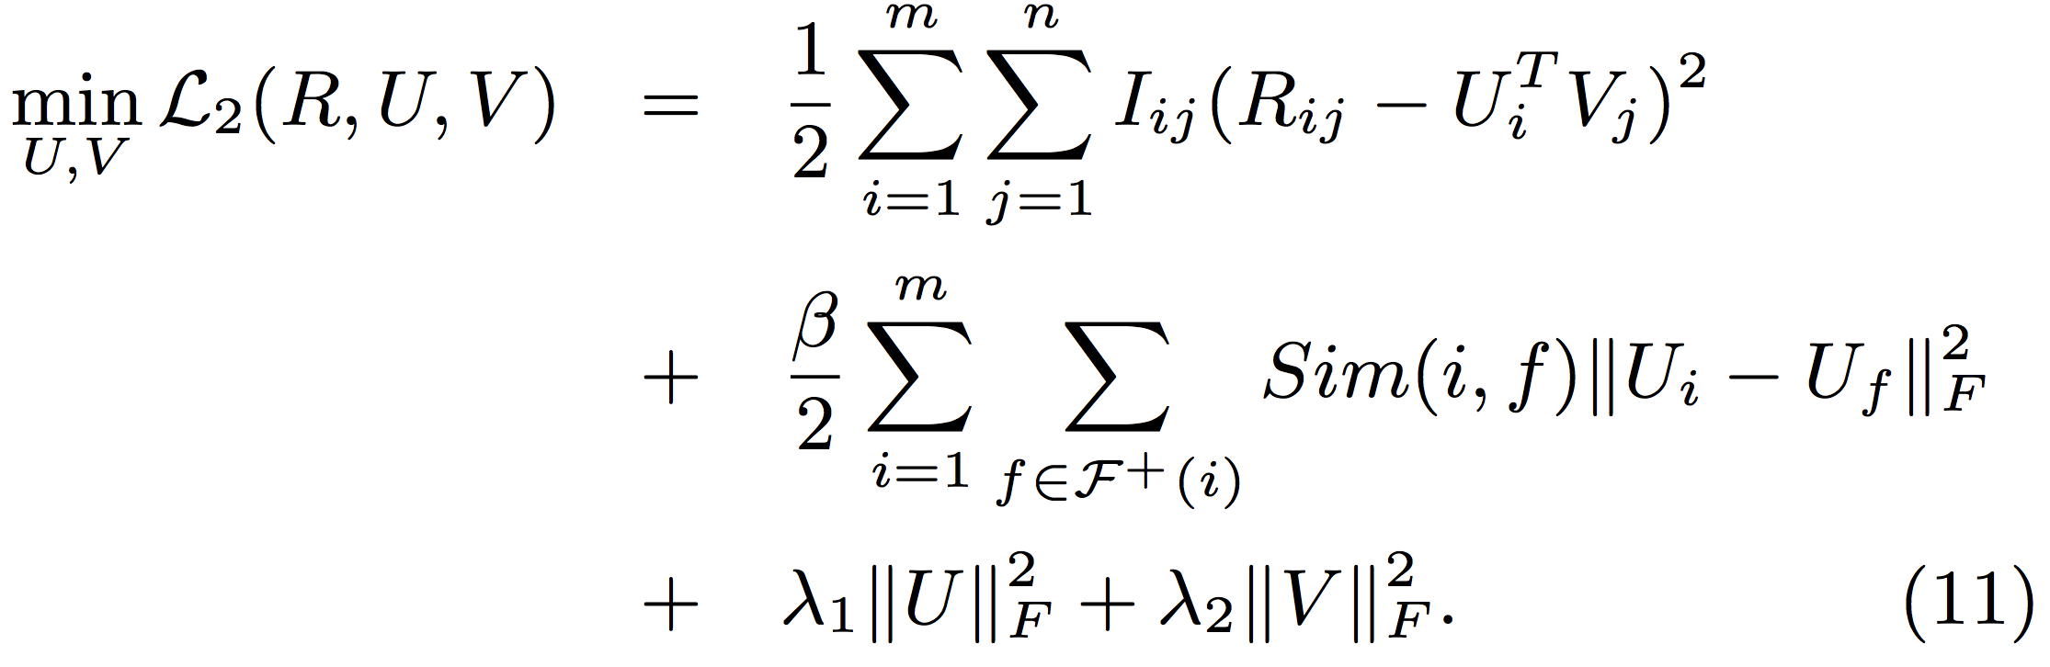
Model based Social Recommender
SoReg
Individual-based regularization:
Regularize with friends individually
Ma et al. Recommender Systems with Social Regularization. WSDM, 2011.
Notes:
In fact, your tastes are similar with your friends who are strongly connected with you. This is better.

Slide 51
Social Recommenders Before 2012
 | Behavior | Social | Trust
SoRec [CIKM’08, TIS’11] | √ | √
“Social Trust” Ensemble [SIGIR’09, TIST’11] | √ |  | √
SoReg [WSDM’11] | √ | √
Social Contextual Information
Jiang et al. Social Contextual Recommendation. CIKM, 2012. Social Recommendation with Contextual Information. TKDE, 2014.

Slide 52
Social Contextual Information
Twitter
social relation
= social
Bob
Amy
Tom
interaction
frequency ≈ trust
Nick
retweeting/
rating = behavior
Additional
signals
item content
Post 1
Post 3
Post 2
Jiang et al. Social Contextual Recommendation. CIKM, 2012. Social Recommendation with Contextual Information. TKDE, 2014.
Notes:
How to integrate all the contextual information for recommendation?

Slide 53


Behavioral Mechanism?
(0) follow
Jiang et al. Social Contextual Recommendation. CIKM, 2012. Social Recommendation with Contextual Information. TKDE, 2014.
Notes:
We should understand the behavioral mechanism. In other words, why does a user adopt a message?

Slide 54
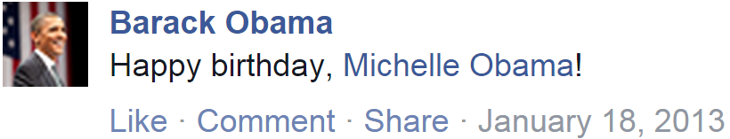
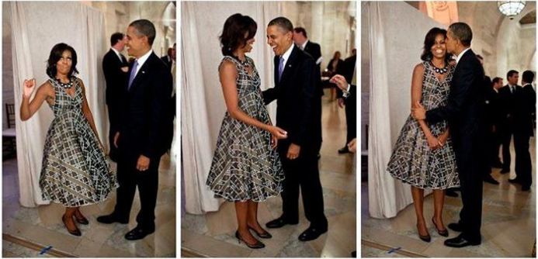
Information Adoption Behavior Intention
(0) follow
(1) post
(2) receive & read
Jiang et al. Social Contextual Recommendation. CIKM, 2012. Social Recommendation with Contextual Information. TKDE, 2014.

Slide 55
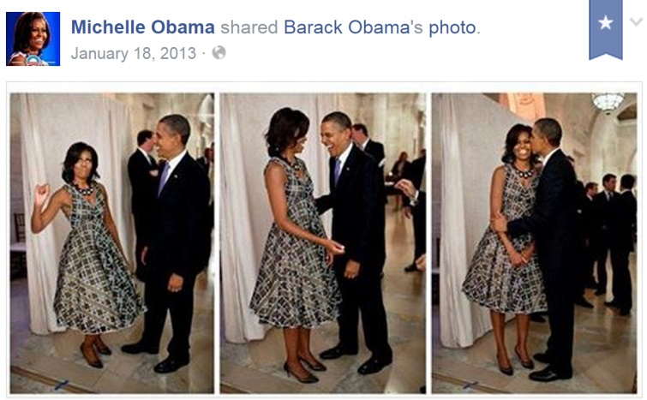
Information Adoption Behavior Intention
(0) follow
(1) post
(2) receive & read
(3) adopt?
Jiang et al. Social Contextual Recommendation. CIKM, 2012. Social Recommendation with Contextual Information. TKDE, 2014.

Slide 56
Information Adoption Behavior Intention
Birthday –
NOT politic issues!
(0) follow
(1) post
(2) receive & read
(3) adopt?
Jiang et al. Social Contextual Recommendation. CIKM, 2012. Social Recommendation with Contextual Information. TKDE, 2014.

Slide 57
Information Adoption Behavior Intention
Birthday –
NOT politic issues!
From my husband –
NOT fans on Twitter!
(0) follow
(1) post
(2) receive & read
(3) adopt?
Jiang et al. Social Contextual Recommendation. CIKM, 2012. Social Recommendation with Contextual Information. TKDE, 2014.

Slide 58
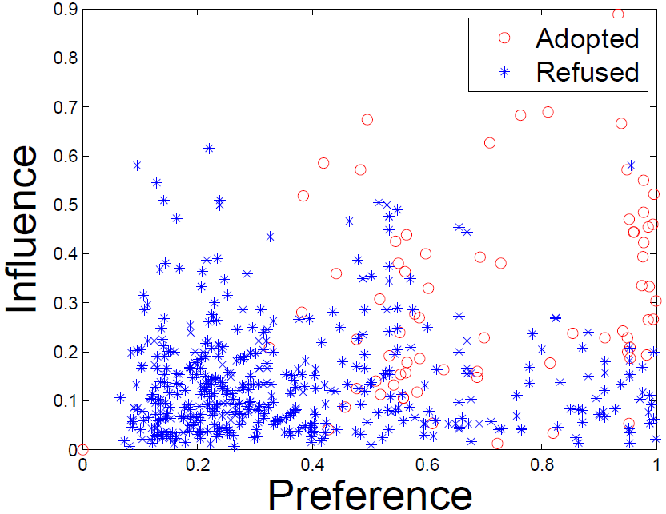
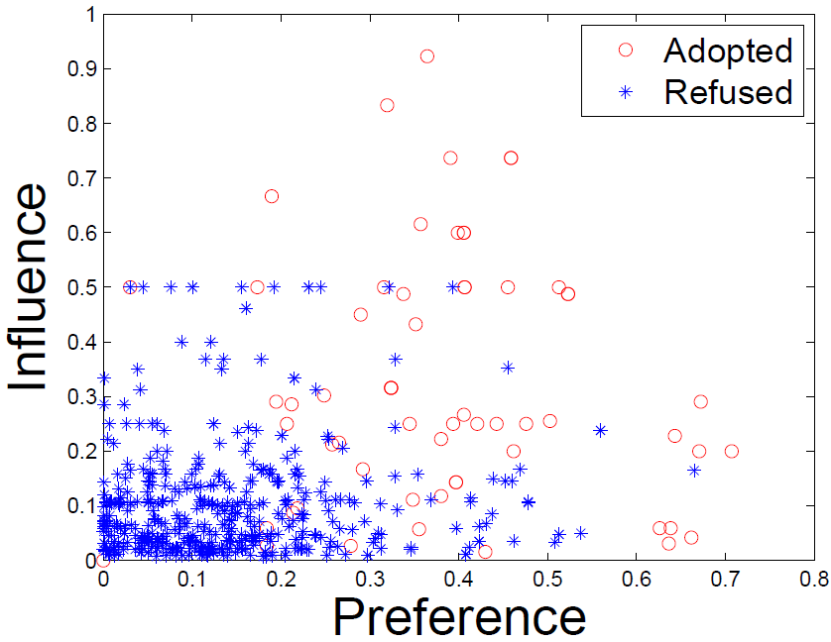
Social Contextual Factors
Individual Preference & Interpersonal Influence
China’s Facebook:
Renren
China’s Twitter:
Tencent Weibo
Jiang et al. Social Contextual Recommendation. CIKM, 2012. Social Recommendation with Contextual Information. TKDE, 2014.

Slide 59
From Information to Factors
Content:
item content
Behavior:
individual preference on the given item
user-item interaction
Social:
social relation
interpersonal influence from the sender
Trust/interaction:
user-user interaction
Jiang et al. Social Contextual Recommendation. CIKM, 2012. Social Recommendation with Contextual Information. TKDE, 2014.

Slide 60
From Information to Factors
Content:
item content
item latent feature V
Behavior:
individual preference on the given item
user-item interaction
user latent feature U
Social:
social relation
interpersonal influence from the sender
Trust/interaction:
user-user interaction
Jiang et al. Social Contextual Recommendation. CIKM, 2012. Social Recommendation with Contextual Information. TKDE, 2014.

Slide 61
From Information to Factors
Content:
item content
item latent feature V
Behavior:
individual preference on the given item
user-item interaction
user latent feature U
Social:
social relation
item sender G
interpersonal influence from the sender
Trust/interaction:
user-user interaction
user-user influence S
Jiang et al. Social Contextual Recommendation. CIKM, 2012. Social Recommendation with Contextual Information. TKDE, 2014.

Slide 62
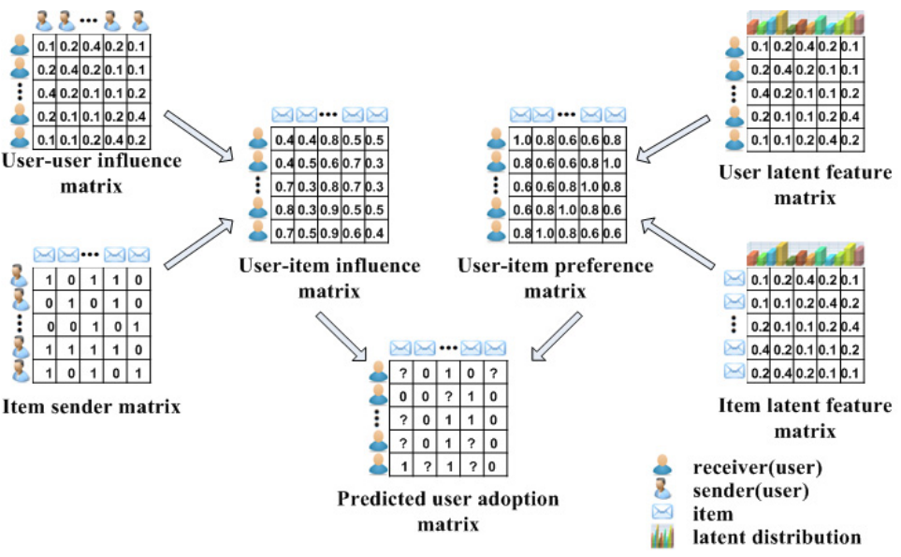
Social Contextual Recommendation
ContextMF
S
U
G
V
R
Jiang et al. Social Contextual Recommendation. CIKM, 2012. Social Recommendation with Contextual Information. TKDE, 2014.

Slide 63
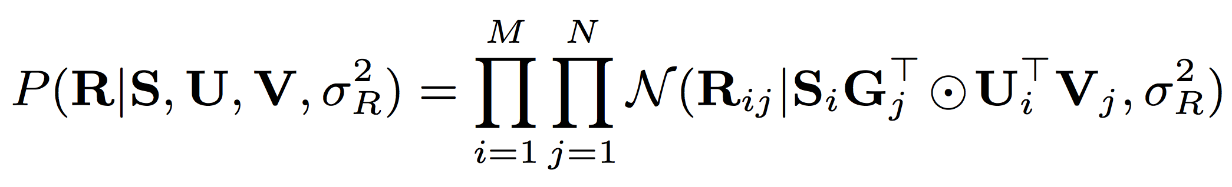
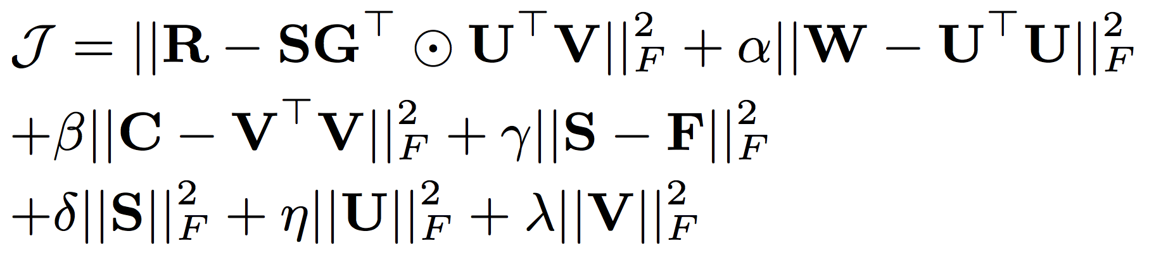
Social Contextual Recommendation
behavior
influence
preference
ContextMF
behavior
interaction frequency/trust
item content
social relation
Jiang et al. Social Contextual Recommendation. CIKM, 2012. Social Recommendation with Contextual Information. TKDE, 2014.

Slide 64
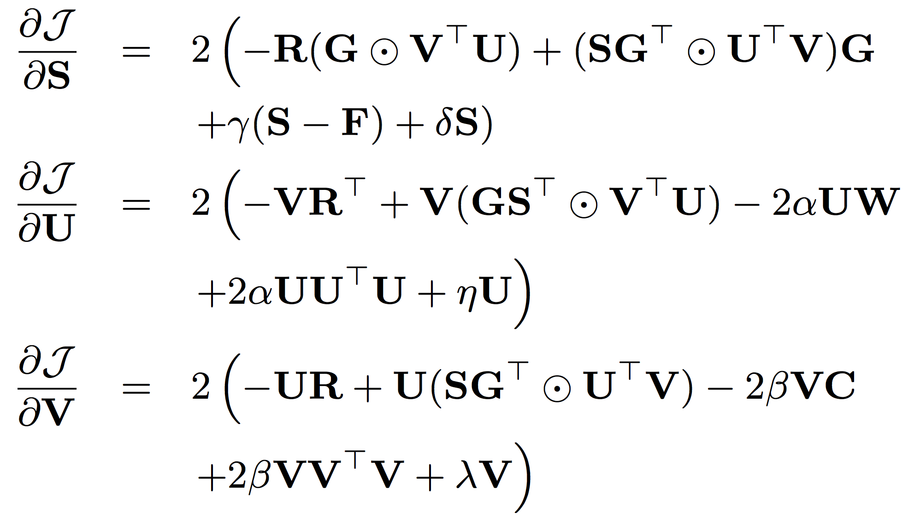
Social Contextual Recommendation
ContextMF
Gradient
Descent
Methods
Jiang et al. Social Contextual Recommendation. CIKM, 2012. Social Recommendation with Contextual Information. TKDE, 2014.

Slide 65
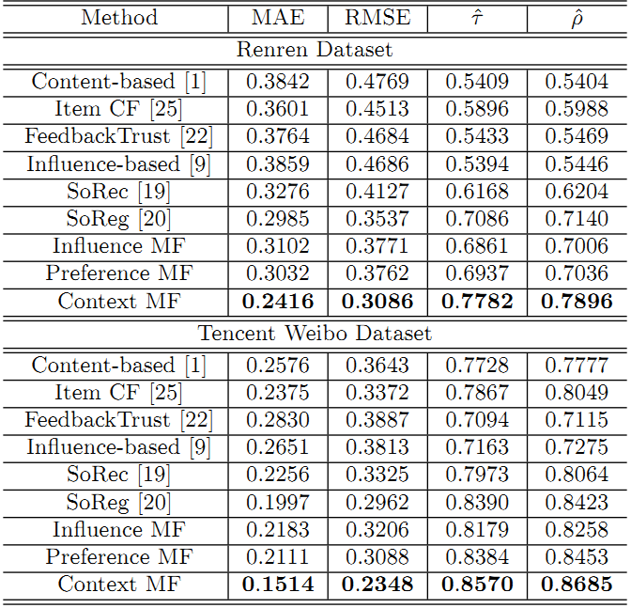
Social Contextual Recommendation
ContextMF
 | Renren | Tencent Weibo
MAE | -19.1% | -24.2%
RMSE | -12.8% | -20.7%
Kendall’s | +9.82% | +2.1%
Spearman’s | +10.6% | +3.1%
Jiang et al. Social Contextual Recommendation. CIKM, 2012. Social Recommendation with Contextual Information. TKDE, 2014.

Slide 66

Co-Predicting Behavior and Social Relations
LOCABAL
social relation
behavior
Observed behavioral data
Observed social relation data
Tang et al. Exploiting Local and Global Social Context for Recommendation. IJCAI, 2013.
Notes:
Co-optimize behavior and social relation.

Slide 67

Co-Predicting Behavior and Social Relations
LOCABAL
Gradient
Descent
Methods
Tang et al. Exploiting Local and Global Social Context for Recommendation. IJCAI, 2013.

Slide 68

Co-Predicting Behavior and Social Relations
LOCABAL
Tang et al. Exploiting Local and Global Social Context for Recommendation. IJCAI, 2013.

Slide 69
Negative Experiences in Social Recommender
Data sparsity problem: sparse matrix.
Social relation are too noisy and may have a negative impact on recommender systems.
It is difficult for social recommenders to improve recommendation performance for cold-start users.
Different types of social relations have different effects on social recommender systems.
Tang et al. Social Recommendation: A Review. Social Network Analysis and Mining, 2013. Springer.

Slide 70
Negative Experiences in Social Recommender
Data sparsity problem: sparse matrix.
Social relation are too noisy and may have a negative impact on recommender systems.
It is difficult for social recommenders to improve recommendation performance for cold-start users.
Different types of social relations have different effects on social recommender systems.
Future work?
Data integration and causal analysis
Tang et al. Social Recommendation: A Review. Social Network Analysis and Mining, 2013. Springer.

Slide 71




Besides Social Context: Spatial Context
Place
Device
Photo
With whom?
Who post?
Text
post
Jiang et al. Flexible Evolutionary Multi-faceted Analysis for Dynamic Behavioral Pattern Discovery. KDD, 2014.

Slide 72

Besides Social Context: Temporal Context
Photo
Text
post
post
time
Jan. 18
Birthday party
@ White house
March 17
St. Patrick’s Day
@ Bar
Jiang et al. Flexible Evolutionary Multi-faceted Analysis for Dynamic Behavioral Pattern Discovery. KDD, 2014.

Slide 73
Modeling Spatiotemporal Contexts
Tasks
time
Who post
Text
Behavior
Place
Behavior modeling
Spatial info:
Multi-faceted
Tensor sequence
Temporal info:
Dynamic
Pattern discovery
Decomposition & Completion
Behavior prediction
≈
x
x
Jiang et al. Flexible Evolutionary Multi-faceted Analysis for Dynamic Behavioral Pattern Discovery. KDD, 2014.

Slide 74
Challenges: Sparsity and Complexity
Addressing sparsity: Flexible regularization with auxiliary data
Addressing high complexity: Incremental updates for projection matrix
Regularization:
Social context
user
item
…
user
item
time
t₃
t₂
time
item
item
t₁
user
user
t₁
t₂
t₃
Jiang et al. Flexible Evolutionary Multi-faceted Analysis for Dynamic Behavioral Pattern Discovery. KDD, 2014.

Slide 75

Flexible Evolutionary Multi-faceted Analysis (FEMA)
Jiang et al. Flexible Evolutionary Multi-faceted Analysis for Dynamic Behavioral Pattern Discovery. KDD, 2014.

Slide 76

Tensor Perturbation Theory
Jiang et al. Flexible Evolutionary Multi-faceted Analysis for Dynamic Behavioral Pattern Discovery. KDD, 2014.

Slide 77



FEMA Algorithm
Approximation
Bound Guarantee
core tensor
projection matrix
Jiang et al. Flexible Evolutionary Multi-faceted Analysis for Dynamic Behavioral Pattern Discovery. KDD, 2014.

Slide 78


Individual Behavior Prediction with FEMA
 | Microsoft Academic Search |  | Tencent Weibo mentions “@”
 | MAE | RMSE | MAE | RMSE
FEMA | 0.735 | 0.944 | 0.894 | 1.312
EMA | 0.794 | 1.130 | 0.932 | 1.556
EA | 0.979 | 1.364 | 1.120 | 1.873
Precision vs Recall
X
L
X
X
Jiang et al. Flexible Evolutionary Multi-faceted Analysis for Dynamic Behavioral Pattern Discovery. KDD, 2014.

Slide 79

Individual Behavior Prediction with FEMA
Re-decomposition:
Re-compute projection matrices
Evolutionary analysis:
Use ΔX to update λ and a
Evolutionary analysis:
Use ΔX to update λ and a
Re-decomposition:
Re-compute projection matrices
Jiang et al. Flexible Evolutionary Multi-faceted Analysis for Dynamic Behavioral Pattern Discovery. KDD, 2014.

Slide 80

Behavioral Pattern: Fan@Idol#Word
Jiang et al. Flexible Evolutionary Multi-faceted Analysis for Dynamic Behavioral Pattern Discovery. KDD, 2014.

Slide 81

Behavioral Pattern: Fan@Idol#Word
Jiang et al. Flexible Evolutionary Multi-faceted Analysis for Dynamic Behavioral Pattern Discovery. KDD, 2014.

Slide 82

Demo 1: Fan@Idol#Word
http://www.meng-jiang.com/demos/fema/weibo/
Jiang et al. Flexible Evolutionary Multi-faceted Analysis for Dynamic Behavioral Pattern Discovery. KDD, 2014.

Slide 83

Demo 2: Author@Affiliation#Keyword
http://www.meng-jiang.com/demos/fema/mas/
Jiang et al. Flexible Evolutionary Multi-faceted Analysis for Dynamic Behavioral Pattern Discovery. KDD, 2014.

Slide 84

Demo 3: Author@Affiliation$Paper&Venue#Keyword
http://www.meng-jiang.com/demos/hindblp/
Jiang et al. Flexible Evolutionary Multi-faceted Analysis for Dynamic Behavioral Pattern Discovery. KDD, 2014.

Slide 85
Modeling social contexts, spatio-temporal contexts: Amazing! …however…

Slide 86
Modeling social contexts, spatio-temporal contexts: Amazing! …however…
Sparsity
in one domain…

Slide 87

Besides Contexts: Multiple Domains
Post
Jiang et al. Social Recommendation across Multiple Relational Domains. CIKM, 2012. Social Recommendation with Cross-Domain Transferable Knowledge. TKDE, 2015.
Notes:
In a social network, we have multiple domains!

Slide 88

Besides Contexts: Multiple Domains
Image
Jiang et al. Social Recommendation across Multiple Relational Domains. CIKM, 2012. Social Recommendation with Cross-Domain Transferable Knowledge. TKDE, 2015.

Slide 89

Besides Contexts: Multiple Domains
Video
Jiang et al. Social Recommendation across Multiple Relational Domains. CIKM, 2012. Social Recommendation with Cross-Domain Transferable Knowledge. TKDE, 2015.

Slide 90

Besides Contexts: Multiple Domains
Social label
Jiang et al. Social Recommendation across Multiple Relational Domains. CIKM, 2012. Social Recommendation with Cross-Domain Transferable Knowledge. TKDE, 2015.

Slide 91

Besides Contexts: Multiple Domains
Group
Jiang et al. Social Recommendation across Multiple Relational Domains. CIKM, 2012. Social Recommendation with Cross-Domain Transferable Knowledge. TKDE, 2015.

Slide 92

Besides Contexts: Multiple Domains
Jiang et al. Social Recommendation across Multiple Relational Domains. CIKM, 2012. Social Recommendation with Cross-Domain Transferable Knowledge. TKDE, 2015.
Notes:
In 2012, a CIKM paper, we proposed a new representation for social network: a star-structured graph. We can represent multiple domains, but how to transfer knowledge across the domains?

Slide 93




Traditional Cross-Domain CF
Codebook Transfer (CBT)
m books
q movies
n users
p users
Li et al. Can Movies and Books Collaborate? Cross-Domain Collaborative Filtering for Sparsity Reduction. IJCAI, 2009.
Notes:
No user nor item can be aligned.

Slide 94

Traditional Cross-Domain CF
m × l
n × k
Codebook Transfer (CBT)
m books
n users
Codebook = User Group × Item Group
k × l
Li et al. Can Movies and Books Collaborate? Cross-Domain Collaborative Filtering for Sparsity Reduction. IJCAI, 2009.
Notes:
No user nor item can be aligned. Sharing/encoding the patterns. S to B.

Slide 95

Traditional Cross-Domain CF
Codebook Transfer (CBT)
Codebook: k × l
q movies
q × l
p × k
p users
Li et al. Can Movies and Books Collaborate? Cross-Domain Collaborative Filtering for Sparsity Reduction. IJCAI, 2009.

Slide 96

Traditional Cross-Domain CF
Codebook Transfer (CBT)
Li et al. Can Movies and Books Collaborate? Cross-Domain Collaborative Filtering for Sparsity Reduction. IJCAI, 2009.

Slide 97

Traditional Cross-Domain CF
Coordinate System Transfer (CST)
m movies
q movies
m movies
n users
p users
n users
auxiliary data
target data
Pan et al. Transfer Learning in Collaborative Filtering for Sparsity Reduction. AAAI, 2010.
Notes:
Aligned users or aligned items.

Slide 98


Traditional Cross-Domain CF
Coordinate System Transfer (CST)
Auxiliary data:
Target data:
Pan et al. Transfer Learning in Collaborative Filtering for Sparsity Reduction. AAAI, 2010.

Slide 99


Traditional Cross-Domain CF
FUSE
tag
tag
book
movie
user
user
Chen et al. Making Recommendation from Multiple Domains. KDD, 2013.
Notes:
Factorization with multiple domains. Tensor factorization.

Slide 100

Traditional Cross-Domain CF
FUSE
Chen et al. Making Recommendation from Multiple Domains. KDD, 2013.
Notes:
Sharing code book to sharing core tensor: multi-d

Slide 101

Traditional Cross-Domain CF
FUSE
Gradient
Descent
Methods
Chen et al. Making Recommendation from Multiple Domains. KDD, 2013.

Slide 102
When Social Recommendation Meets Multiple Domains
Utgt
Uaux1
Rtgt
Raux1
Uaux3
Uaux2
Raux3
Raux2
Bridge: User×Cluster
Jiang et al. Social Recommendation across Multiple Relational Domains. CIKM, 2012. Social Recommendation with Cross-Domain Transferable Knowledge. TKDE, 2015.
Notes:
Factorization. Sharing user vector as bridge.

Slide 103
When Social Recommendation Meets Multiple Domains
Social
Bridge
Jiang et al. Social Recommendation across Multiple Relational Domains. CIKM, 2012. Social Recommendation with Cross-Domain Transferable Knowledge. TKDE, 2015.
Notes:
Social network with the tie strength (social relation strength between users) should be the natural bridge among the domains.

Slide 104
When Social Recommendation Meets Multiple Domains
Rtgt
Raux1
Raux3
Raux2
Bridge: User×User
Jiang et al. Social Recommendation across Multiple Relational Domains. CIKM, 2012. Social Recommendation with Cross-Domain Transferable Knowledge. TKDE, 2015.

Slide 105

Hybrid Random Walk
Starting with a Second-Order Start-Structured Graph
Jiang et al. Social Recommendation across Multiple Relational Domains. CIKM, 2012. Social Recommendation with Cross-Domain Transferable Knowledge. TKDE, 2015.

Slide 106






Hybrid Random Walk
Updating cross-domain links
Updating within-domain links
Jiang et al. Social Recommendation across Multiple Relational Domains. CIKM, 2012. Social Recommendation with Cross-Domain Transferable Knowledge. TKDE, 2015.

Slide 107

Hybrid Random Walk
High-Order Star-Structured Graph
Jiang et al. Social Recommendation across Multiple Relational Domains. CIKM, 2012. Social Recommendation with Cross-Domain Transferable Knowledge. TKDE, 2015.

Slide 108


Hybrid Random Walk
Comparing with Random Walk with Restarts Models
Comparing with Social Recommendation Baselines
Jiang et al. Social Recommendation across Multiple Relational Domains. CIKM, 2012. Social Recommendation with Cross-Domain Transferable Knowledge. TKDE, 2015.

Slide 109

Hybrid Random Walk
Knowledge transfer from auxiliary domains improves cold-start users’ behavior prediction
Using aux. (label) data, saving 60-70% tgt. (post) data
35% user-post
0 user-label
0 user-post
100% user-label
60% user-post
0 user-label
18% user-post
100% user-label
Jiang et al. Social Recommendation across Multiple Relational Domains. CIKM, 2012. Social Recommendation with Cross-Domain Transferable Knowledge. TKDE, 2015.

Slide 110
Besides Cross-Domain…
How about Cross-Platform?
Partially aligned/overlapped users!
Little is Much: Bridging Cross-Platform Behaviors through Overlapped Crowds
by M. Jiang, P. Cui, N. J. Yuan, X. Xie, S. Yang. AAAI Conference on Artificial Intelligence (AAAI) , 2016.

Slide 111
Questions for Modeling Individual Behavior
What is individual behavior in social networks?
Why should we study individual behavior?
What are the state-of-the-art models?
Modeling behaviors and social relations
Modeling social contexts
Modeling spatiotemporal contexts
Modeling multiple domains in social networks

Slide 112
Summary for Modeling Individual Behavior
Like, Reply, Share, Retweet, Favorite, Comment …
Pattern discovery, prediction and social recommendation
Memory based social recommenders
TidalTrust, MoleTrust, TrustWalker
Model based social recommenders
SoRec, “Social Trust” Ensemble, SoReg
ContextMF: Social contexts (preference & influence)
FEMA: Spatiotemporal contexts (multi-faceted & dynamic)
Traditional cross-domain CF
CBT, CST, FUSE
Hybrid Random Walk: Social bridging multiple domains

Slide 113
Outline
Prediction for natural behavior
Modeling individual behavior (MICRO)
Modeling information cascade (MACRO)
Detection for unnatural behavior
Suspicious behavior detection

Slide 114
From Micro to Macro
Dynamically Aggregate
Information spreading is a macro phenomenon which is driven by individual user behaviors in microscopic level.
Notes:
Information spreading is a phenomenon in our daily life.
For example, when iphone just invented, some celebrities used it… then you just recommend this to your friends…
Formally speaking….
We should say…
How to model and understand information cascades is a challenging issue.

Slide 115

Cascades: Information Spreading
In network environment, if decentralized nodes act on the basis of how their neighbors act at earlier time, cascades will be formed.
Word-of-mouth
Cascading
Diffusion
Propagation
Notes:
Information spreading is a phenomenon in our daily life.
For example, when iphone just invented, some celebrities used it… then you just recommend this to your friends…
Formally speaking….
We should say…
How to model and understand information cascades is a challenging issue.

Slide 116

Information Spreading is Ubiquitous
Social Media
Information spreading is the major way of communication in social media.
Notes:
In our real life, information spreading is ubiquitous….
It has been demonstrated that all of them…..
So if we can figure out the spreading mechanism…. Then these technologies can be applied into various application scenarios, including…

Slide 117

Information Spreading is Ubiquitous
Word-of-Mouth (Marketing)
How to fully exploit the power of word-of-mouth in marketing?
Notes:
In our real life, information spreading is ubiquitous….
It has been demonstrated that all of them…..
So if we can figure out the spreading mechanism…. Then these technologies can be applied into various application scenarios, including…

Slide 118

Information Spreading is Ubiquitous
Epidemics
Share similar dynamic process as information spreading.
Notes:
In our real life, information spreading is ubiquitous….
It has been demonstrated that all of them…..
So if we can figure out the spreading mechanism…. Then these technologies can be applied into various application scenarios, including…

Slide 119

Information Spreading is Ubiquitous
Traffic
Traffic jams spread through road network. How to model, predict and intervene?
Notes:
In our real life, information spreading is ubiquitous….
It has been demonstrated that all of them…..
So if we can figure out the spreading mechanism…. Then these technologies can be applied into various application scenarios, including…

Slide 120
How to understand information spreading mechanism, and furthermore, predict the information spreading process?
Notes:
So the central problem is….

Slide 121
Related Research
Understand
Prediction
Rise and fall patterns in cascading curve
Popularity prediction
Structural units of information cascades
Regard cascades as a whole and extract cascade-level features for understanding and prediction.

Slide 122
Macro Phenomenon v.s. Micro Mechanism
Information spreading is driven by a cascade of user adoption behaviors.
Micro
Behavioral Dynamics
Macro
Information Spreading
Notes:
Most of these research just investigate information spreading as a macro phenomenon, and then extract some macro-level features to characterize the information cascades. Few of them think about the micro mechanism of information spreading…
In our opinion…
So under the macro phenomenon, there exist the micro mechanism that drives the information spreading process, and that is the behavioral dynamics.

Slide 123
Behavior-Driven Information Spreading Modeling
Ultimate Goal: Bridge the gap between macro phenomena of information spreading and micro behavioral mechanism.
One-Hop Cascade Prediction
Cascading Outbreak Prediction
Dynamic Process Prediction
Predict the collective response of a user’s followers
Predict whether the information will break out in future
Predict the dynamic cascading process of a piece of information
SIGIR’11, AAAI’11
KDD’13
ICDM’15
Notes:
In order to understand and predict information spreading, the key problem is to bridge the gap between micro behavioral dynamics and the macro cascading phenomena.
And the ultimate goal is to …
In recent years, we conduct some research along this line.

Slide 124


The problem:
To predict the percentage of a user’s followers that will retweet the microblog after the user retweet it.
Notes:
Number of forwarding.

Slide 125

The Dimensions
Are big users always trigger high forwarding numbers?
Post Variance
User Variance
Are popular tweets always trigger high forwarding numbers?
Notes:
However, the number is not easy to predict. X-axis: number of forwarding.

Slide 126
Problem Formulation
U1
U2
U3
Observed
P1
Predicted
P2
P3
Given an user, rank the web posts to share
Given a web post, rank the users to target

Slide 127
Density 0.1%
We need priors on users and posts.

Slide 128


Predictive Factors
Percentage of active friends
Notes:
Call the percentage of forwarding users: influence. Mean value: active friends, tie strength. Variance: topic.

Slide 129


Predictive Factors
Average tie strength
Notes:
Call the percentage of forwarding users: influence. Mean value: active friends, tie strength. Variance: topic.

Slide 130

Predictive Factors
The introduction of post topic groups can reduce the variances of influences.
Notes:
Focus on each topic, the variance becomes smaller. Call the percentage of forwarding users: influence. Mean value: active friends, tie strength. Variance: topic.

Slide 131



Modeling
Baseline objective function
We suppose the users with similar observed predictive factors have similar distribution in latent space
User similarity matrix
We constrain the latent post space by topic distributions
Post content matrix
Topic matrix

Slide 132

Modeling
Hybrid Factor Non-Negative Matrix Factorization (HF-NMF)

Slide 133



Ranking Criterion
The advantages of HF-NMF is more apparent in ranking evaluations.
Examples
For a user, ranking the posts
For a post, ranking the users

Slide 134
Discussions
The collective retweeting behaviors of a user’s followers is predictable in fine granularity.
Can we use the results of one-hop cascade prediction to predict the whole cascades? No!
Inapplicable in real applications
Error aggregation
Hint: Different users play different roles in information spreading.

Slide 135
Predictive Modeling on Information Spreading
Ultimate Goal: Bridge the gap between macro phenomena of information spreading and micro behavioral mechanism.
One-Hop Cascade Prediction
Cascading Outbreak Prediction
Dynamic Process Prediction
Predict the collective response of a user’s followers
Predict whether the information will break out in future
Predict the dynamic cascading process of a piece of information
SIGIR’11, AAAI’11
KDD’13
ICDM’15
Notes:
In order to understand and predict information spreading, the key problem is to bridge the gap between micro behavioral dynamics and the macro cascading phenomenoa.
And the ultimate goal is to …
In recent years, we conduct some research along this line.

Slide 136
Cascading Outbreak Prediction
Can we predict whether a tweet will be hot in future?

Slide 137
Outbreak prediction
Basic Hypothesis: User behaviors cause outbreaks
Experience: Different users play different roles in causing outbreaks
How to identify the important users?
Topology measures
Indegree, centralities, etc.
Influential nodes
Suppose the cascading process
But does the real data follow the hypothesized cascading process and topology measures?
Notes:
Physics, beautiful hypothesis – assume the distributions match Poisson, Exponential… however

Slide 138

A Data Driven Approach
Mining from massive historical data
Early stage users as features
Paths as samples
Outbreak signals
Selected as sensors to predict outbreaks
Notes:
User as sensors / features for the paths. Label: outbreak signal, exceeds a number (100,1000). Select early stage users, not every user.

Slide 139
Challenges
The outbreak prediction and node selection procedures need to be jointly optimized
The node selection need to be parsimonious so that the monitoring over the selected sensors can be cost effective
The node selection process need to be efficient so that the method can be applied into large realistic networks
Notes:
Two tasks. Save time and money. Efficient.

Slide 140


Orthogonal Sparse LOgistic Regression (OSLOR)
Notes:
Maximize logistic regression equation L(theta). T3, the number of powerful users should be limited (L1 regularization on theta). T2, the behaviors of the powerful users are complementary. We want the behaviors of the powerful users to have minimum redundancy, so that we can obtain the most representative users as selected sensors. We add an orthogonality regularization term on the users’ behavior vectors, which is T2.

Slide 141
A Showcase
Notes:
Use sensor, 2,474 seconds. Real outbreak, 13,620 seconds.

Slide 142
Prediction Performance
Our approach performs best
Data driven approaches outperforms topology-based approaches
Big nodes’ participation will cause outbreaks in most cases
Only a part of outbreaks are caused by big nodes
Notes:
Black is OSLOR. Precision, recall, F1. Only a part of outbreaks are caused by big nodes - In-degree has good precision but not recall.

Slide 143
Prediction Leading Time
We only need 5 mins to predict the information outbreaks!
Peng Cui, Shifei Jin, Linyun Yu, Fei Wang, Shiqiang Yang, Cascading Outbreak Prediction in Networks: A Data-Driven Approach, ACM SIGKDD 2013. (Full Paper)
Notes:
Middle figure: 0-5 minutes.

Slide 144
Discussions
Studying information spreading from user behavior angle is effective and promising.
Many traditional hypothesis on the node importance and diffusion mechanism are not consistent with the real data.
This is a one-shot study. Can we make continuous prediction on the information spreading?

Slide 145
Predictive Modeling on Information Spreading
Ultimate Goal: Bridge the gap between macro phenomena of information spreading and micro behavioral mechanism.
One-Hop Cascade Prediction
Cascading Outbreak Prediction
Dynamic Process Prediction
Predict the collective response of a user’s followers
Predict whether the information will break out in future
Predict the dynamic cascading process of a piece of information
SIGIR’11, AAAI’11
KDD’13
ICDM’15
Notes:
Best Student Research Paper. 15th afternoon.
In order to understand and predict information spreading, the key problem is to bridge the gap between micro behavioral dynamics and the macro cascading phenomenoa.
And the ultimate goal is to …
In recent years, we conduct some research along this line.

Slide 146
Beyond Cascade Size…
Time:
When will a cascade break out?
Size-Time:
How about the momentum of a cascade?
Cascading Process Prediction
Notes:
A novel problem. Predicting the whole process.

Slide 147
Challenge: Cascade-level macro features do not work. Content feature and structure feature
are not distinctive and predictive enough.
Notes:
So the central problem is….

Slide 148

From Micro to Macro: Subcascades
How to model subcascades?
How to connect subcascades and cascade?

Slide 149
Behavioral Dynamics
Behavioral Dynamics capture the changing process of the cumulative number of a user’s followers retweeting a post after the user retweet the post.
Survival Rate represent the percentage of nodes that has not been but will be infected.
Behavioral dynamics can be well represented by survival function.
Notes:
Three discoveries: Discovery 1. Survival Rate for individual behavioral dynamics. Blue: the subcascades that the user joins are often different. Their size growth patterns vary. But the survival function is quite stable for different subcascades.

Slide 150

Parameterize Behavioral Dynamics
Characteristics of behavioral dynamics can be well captured by Weibull distribution.
Notes:
Discovery 2. Use Weibull model which is a general model that have two parameters, lambda for size, k for shape, to parameterize behavioral dynamics. The ks-statics is quite small!

Slide 151
From Behavioral Dynamics to Cascades
Macro
Micro

Slide 152
NEtworked WEibull Regression (NEWER)
Theoretically proved to be lower-bounded.
Coordinate Descent strategy is exploited with guaranteed convergence.
Notes:
Logistic regression based on Weibull model. Terms, co-optimize with networked information.

Slide 153
Experiments
Datasets: Tencent Weibo
All cascades generated between Nov 15th and Nov 25th in 2011.
retain all 0.59 million cascades that the cascades size are at least 5.
Baseline:
Cox Proportional Hazard Regression Model (Cox)
Exponential/Rayleigh Proportional Hazard Regression Model (Exponential/Rayleigh)
log-Linear regression(Log-linear)
Evaluation metric:
RMSLE: Root Mean Square Log Error
∆σ-Precision: Precision value that the predicted value within (1+σ)±1groundtruth

Slide 154
Cascade Size Prediction
What is the final size of the cascade?

Slide 155
Outbreak Time Prediction
When will the cascade break out?

Slide 156
Cascading Process Prediction
What is the size of the cascade at any later point?

Slide 157
Conclusions
Before predicting information spreading, understanding the behavioral mechanism is critical and fundamental.
Behaviors can be modeled in different granularities, which depends on the target problem.
Modeling information spreading with continuous-time model is promising and demonstrated to be effective in our research.

Slide 158
Outline
Prediction for natural behavior
Modeling individual behavior (MICRO)
Modeling information cascade (MACRO)
Detection for unnatural behavior
Suspicious behavior detection

Slide 159


Suspicious Behavior Detection
JIANG,
Meng
(UIUC)
CUI,
Peng
(Tsinghua)
FALOUTSOS,
Christos
(CMU)
Suspicious Behavior Detection: Current Trends and Future Directions.
Special Issue on Online Behavioral Analysis and Modeling, IEEE Intelligent Systems Magazine (ISSI), 2016. (to appear)

Slide 160
Suspicious Behavior Detection
Social Link Farming
JIANG,
Meng
(UIUC)
CUI,
Peng
(Tsinghua)
FALOUTSOS,
Christos
(CMU)
Suspicious Behavior Detection: Current Trends and Future Directions.
Special Issue on Online Behavioral Analysis and Modeling, IEEE Intelligent Systems Magazine (ISSI), 2016. (to appear)

Slide 161

Social Link Farming
Selling Twitter followers

Slide 162

Social Link Farming
Selling Facebook Likes

Slide 163
Suspicious Behavior Detection
Detecting suspicious behavioral patterns
Spotting: Lockstep patterns
Methods that can spot strange behaviors
Catching: Synchronized patterns
Scalable algorithms with theoretical guarantee
Solving: Suspiciousness in multiple dimensions
A principled metric for suspiciousness

Slide 164
Lockstep Behavior: Facebook Likes
Beutel et al. CopyCatch: Stopping Group Attacks by Spotting Lockstep Behavior in Social Neworks. WWW, 2013.

Slide 165

Lockstep Behavior: Facebook Likes
Beutel et al. CopyCatch: Stopping Group Attacks by Spotting Lockstep Behavior in Social Neworks. WWW, 2013.

Slide 166

Lockstep Behavior: Graphical View
Beutel et al. CopyCatch: Stopping Group Attacks by Spotting Lockstep Behavior in Social Neworks. WWW, 2013.

Slide 167

Lockstep Behavior: Reorder Matrix
Beutel et al. CopyCatch: Stopping Group Attacks by Spotting Lockstep Behavior in Social Neworks. WWW, 2013.

Slide 168

Lockstep Behavior: Seed + Search
CopyCatch
“Near Bipartite Core”: n users, m Pages, ρ, Δt
Beutel et al. CopyCatch: Stopping Group Attacks by Spotting Lockstep Behavior in Social Neworks. WWW, 2013.

Slide 169

Lockstep Behavior: Performance
CopyCatch
Beutel et al. CopyCatch: Stopping Group Attacks by Spotting Lockstep Behavior in Social Neworks. WWW, 2013.

Slide 170
Lockstep Behavior: Performance
CopyCatch
Seed Selection!!!
Beutel et al. CopyCatch: Stopping Group Attacks by Spotting Lockstep Behavior in Social Neworks. WWW, 2013.

Slide 171


Lockstep Behavior: Twitter Followers
Follow
× 1,000
× 100
× 5,000
× 100
× ….
× ….
Jiang et al. Inferring Strange Behavior from Connectivity Pattern in Social Networks. PAKDD, 2014.

Slide 172




Lockstep Behavior: Reorder Matrix
Seeds
Given
Reorder
Jiang et al. Inferring Strange Behavior from Connectivity Pattern in Social Networks. PAKDD, 2014.

Slide 173
Lockstep Behavior: SVD Reminder
followee
followee
1
U₁U₂
×
…
V₁V₂
×
follower
follower
×
follow
2
×
Graph Structure
Adjacency Matrix
SVD: A=USV^{T}
Jiang et al. Inferring Strange Behavior from Connectivity Pattern in Social Networks. PAKDD, 2014.

Slide 174
Lockstep Behavior: Spectral Subspace
followee
U₁U₂
…
V₁V₂
follower
Pairs of singular vectors:
SVD: A=USV^{T}
U₂
V₂
U₁
V₁
“Spectral Subspace Plot”
Jiang et al. Inferring Strange Behavior from Connectivity Pattern in Social Networks. PAKDD, 2014.

Slide 175


Spectral Subspace Plot: Case #0
NO lockstep behavior: Scatter
Adjacency Matrix
Spectral Subspace Plot
Jiang et al. Inferring Strange Behavior from Connectivity Pattern in Social Networks. PAKDD, 2014.

Slide 176

Spectral Subspace Plot: Case #1
Non-overlapping lockstep: “Rays”
Adjacency Matrix
Spectral Subspace Plot
Jiang et al. Inferring Strange Behavior from Connectivity Pattern in Social Networks. PAKDD, 2014.

Slide 177

Spectral Subspace Plot: Case #2
Non-overlapping: Low density, Elongation
Adjacency Matrix
Spectral Subspace Plot
Jiang et al. Inferring Strange Behavior from Connectivity Pattern in Social Networks. PAKDD, 2014.

Slide 178

Spectral Subspace Plot: Case #3
Non-overlapping: Camouflage/Fame, Tilting
Adjacency Matrix
Spectral Subspace Plot
Jiang et al. Inferring Strange Behavior from Connectivity Pattern in Social Networks. PAKDD, 2014.

Slide 179

Spectral Subspace Plot: Case #4
Overlapping: “Staircase”, “Pearls”
Adjacency Matrix
Spectral Subspace Plot
Jiang et al. Inferring Strange Behavior from Connectivity Pattern in Social Networks. PAKDD, 2014.

Slide 180

Spectral Subspace Plot: Reading & LockInfer
Spectral
Subspace Plot
Polar Coordinate
Transform
Histograms
Jiang et al. Inferring Strange Behavior from Connectivity Pattern in Social Networks. PAKDD, 2014.

Slide 181



Graphical View: Power-Law Distribution
Out-degree distribution
DBLP Author-publication | Flickr User-user | Twitter Who-follows-whom
[konect.uni-koblenz.de/networks/]
Jiang et al. CatchSync: Catching Synchronized Behavior in Large Directed Graphs. KDD Best Paper Finalist, 2014.

Slide 182




2009
41M
2011
117M
3.17M
1.91M
0.41M
0.44M
d=20
d=64
Jiang et al. CatchSync: Catching Synchronized Behavior in Large Directed Graphs. KDD Best Paper Finalist, 2014.

Slide 183





Synchronized Behavior: Features
Synchronized
Abnormal
Jiang et al. CatchSync: Catching Synchronized Behavior in Large Directed Graphs. KDD Best Paper Finalist, 2014.

Slide 184



Synchronized Behavior: Synchronicity
Jiang et al. CatchSync: Catching Synchronized Behavior in Large Directed Graphs. KDD Best Paper Finalist, 2014.

Slide 185


Synchronized Behavior: Normality
Jiang et al. CatchSync: Catching Synchronized Behavior in Large Directed Graphs. KDD Best Paper Finalist, 2014.

Slide 186

Synchronized Behavior: Theorem & CatchSync
Synchronicity-Normality Plot
Jiang et al. CatchSync: Catching Synchronized Behavior in Large Directed Graphs. KDD Best Paper Finalist, 2014.

Slide 187
Synchronized Behavior: Performance
CatchSync+SPOT
CatchSync
SPOT
OutRank
CatchSync+SPOT
CatchSync
SPOT
OutRank
Jiang et al. CatchSync: Catching Synchronized Behavior in Large Directed Graphs. KDD Best Paper Finalist, 2014.

Slide 188


Synchronized Behavior: Performance
2009
3.17M
41M
0.41M
d=20
Jiang et al. CatchSync: Catching Synchronized Behavior in Large Directed Graphs. KDD Best Paper Finalist, 2014.

Slide 189
Beyond Graph: Multi-Dimensional Fraud
My boss wants me to
catch fraud in such a big table – billions of records, tens of columns!!! How?!
fraud
Jiang et al. A General Suspicious Metric for Dense Blocks in Multi-Modal Data. ICDM, 2015.

Slide 190

Multi-Dimensional Fraud
Jiang et al. A General Suspicious Metric for Dense Blocks in Multi-Modal Data. ICDM, 2015.

Slide 191
Multi-Dimensional Fraud
Dataset | Mode |  |  |  | Mass
Retweeting | User | Root ID | IP | Time (min) | #retweet
 | 29.5M | 19.8M | 27.8M | 56.9K | 211.7M
Trending (Hashtag) | User | Hashtag | IP | Time (min) | #tweet
 | 81.2M | 1.6M | 47.7M | 56.9K | 276.9M
Network attacks (LBNL) | Src-IP | Dest-IP | Port | Time (sec) | #packet
 | 2,345 | 2,355 | 6,055 | 3,610 | 230,836
Jiang et al. A General Suspicious Metric for Dense Blocks in Multi-Modal Data. ICDM, 2015.

Slide 192


Suspiciousness: Density in Multi-Dimensions
200 minutes
120 minutes
time
time
user
225
user
40
IP
12,375
2
27,313
Question: Which is more suspicious?
- Before we search, we should be able to rank.
Jiang et al. A General Suspicious Metric for Dense Blocks in Multi-Modal Data. ICDM, 2015.

Slide 193

Suspiciousness: Axiom 1 - 4
Jiang et al. A General Suspicious Metric for Dense Blocks in Multi-Modal Data. ICDM, 2015.

Slide 194
Suspiciousness: Axiom 5 Multimodal
Not including a mode is the same as
including all values for that mode.
=
▶ New information (more modes) can only
make our blocks more suspicious

Slide 195
Suspiciousness: General Metric & CrossSpot
200 minutes
120 minutes
time
time
user
225
user
40
IP
12,375
2
27,313
Jiang et al. A General Suspicious Metric for Dense Blocks in Multi-Modal Data. ICDM, 2015.

Slide 196
Suspiciousness: General Metric & CrossSpot
200 minutes
120 minutes
time
time
user
225
user
40
IP
12,375
2
27,313
Probability
0.9%
0.05%
Jiang et al. A General Suspicious Metric for Dense Blocks in Multi-Modal Data. ICDM, 2015.

Slide 197

Suspiciousness: General Metric & CrossSpot
Negative log likelihood of block’s probability
Jiang et al. A General Suspicious Metric for Dense Blocks in Multi-Modal Data. ICDM, 2015.

Slide 198


Suspiciousness: Trend Manipulating
Jiang et al. A General Suspicious Metric for Dense Blocks in Multi-Modal Data. ICDM, 2015.

Slide 199
Summary for Detecting Unnatural Behavior
Suspicious behavioral patterns
Lockstep pattern: CopyCatch, LockInfer
Synchronized pattern: CatchSync
Multi-dimensional suspiciousness: CrossSpot

Slide 200
Take AWAY
Behavior Modeling in Social Networks

Slide 201
Six Disruptive Basic Research Areas, by DOD
Notes:
DOD (Department of Defense) also list computation modeling of human behaviors as one of the six disruptive basic research directions.

Slide 202
From Micro to Macro
Individual
behavior
Natural
behavior
Information
cascade
Unnatural/Suspicious
behavior

Slide 203
Modeling Individual Behavior
Pattern discovery, prediction and social recommendation
ContextMF: Social contexts (preference & influence)
FEMA: Spatiotemporal contexts (multi-faceted & dynamic)
Hybrid Random Walk: Social bridging multiple domains

Slide 204
Modeling Cascading Behavior
Before predicting information spreading, understanding the behavioral mechanism is critical and fundamental.
Behaviors can be modeled in different granularities, which depends on the target problem.
Modeling information spreading with continuous-time model is promising and demonstrated to be effective in our research.

Slide 205
Detecting Unnatural Behavior
Suspicious behavioral patterns
Lockstep pattern: CopyCatch, LockInfer
Synchronized pattern: CatchSync
Multi-dimensional suspiciousness: CrossSpot

Slide 206








Acknowledge
Prof. Chaoming Song
Miami University
Prof. Christos Faloutsos
CMU
Prof. Shiqiang Yang
Tsinghua
Prof. Fei Wang
University of Connecticut
Bryan Hooi
CMU
Alex Beutel
CMU
Prof. Wenwu Zhu
Tsinghua
Shifei Jin
Tsinghua

Slide 207
Thank you!
Behavior Modeling in Social Networks

